Slide 1
When a Decade is Not Enough: Long-Term Synoptic Data Records, Their Continuity and Preservation
Dr. Alexei A. Pevtsov
National Solar Observatory

Slide 2
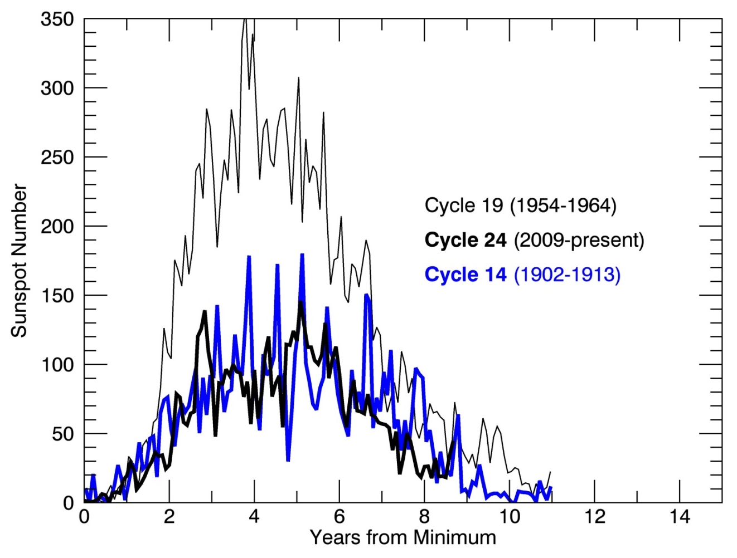
Why “synoptic” if we have new high-resolution data?
How unusual cycle 24 is?
What is a “typical” sunspot/flare/filament?
Would sunspots disappear some day?
Does Sun approach new grand (Maunder-type) minimum?
How solar activity will change over next 20 years?
C14
C14
C24
Dalton
Minimum
1796-1820
C24
Dalton
Minimum
1796-1820

Slide 3
Why long-term/synoptic programs?
Benchmarking: provide reference for “typical/ normal” state of natural systems (sun)
Systemic change: Provide information about evolutionary changes in natural systems
Exploratory: synoptic observations of solar activity feed future research to solve issues that may not be identified at the time when data are acquired

Slide 4
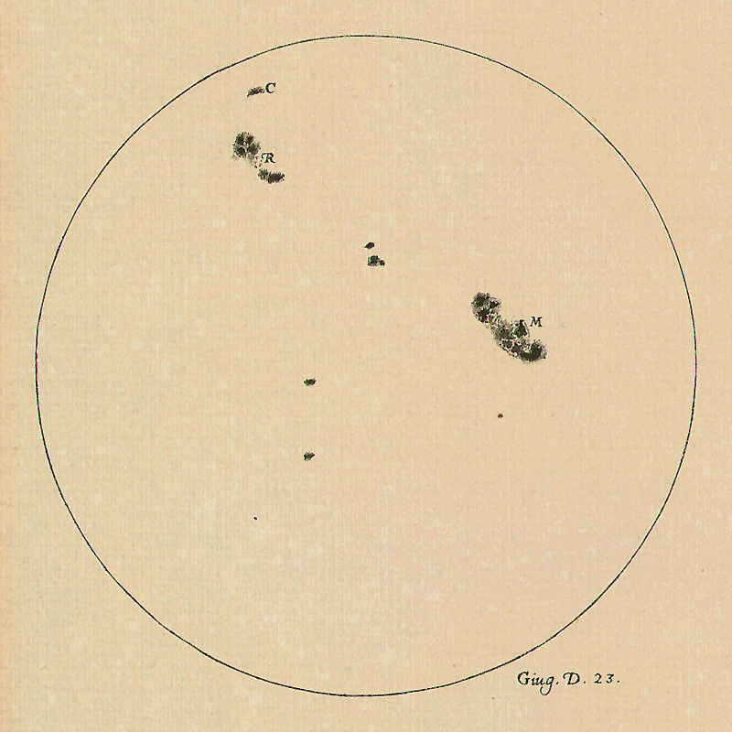
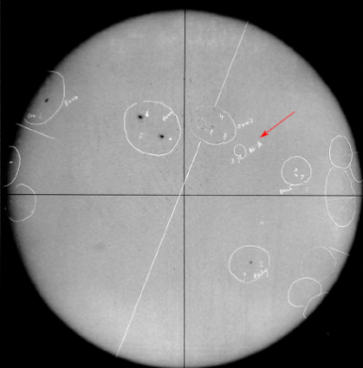
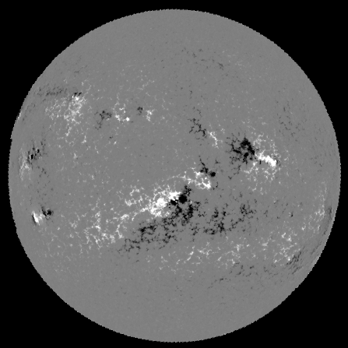
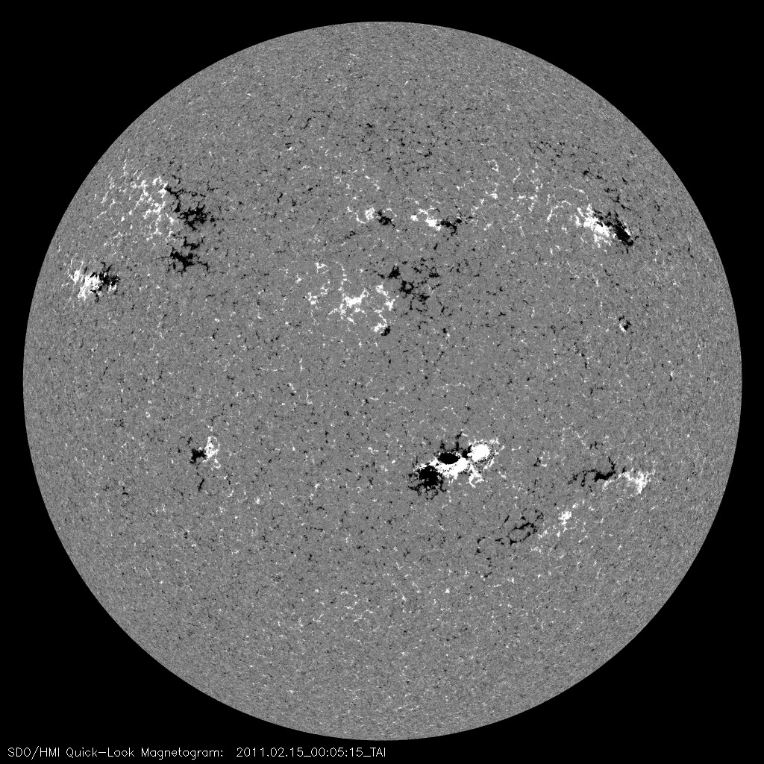
How useful “old” data are?
RGO
Kodaikanal/MWO
NSO
HMI/SDO
Galileo, 1613
Willis et al (2016)

Slide 5
Synoptic/Carrington maps

Slide 6
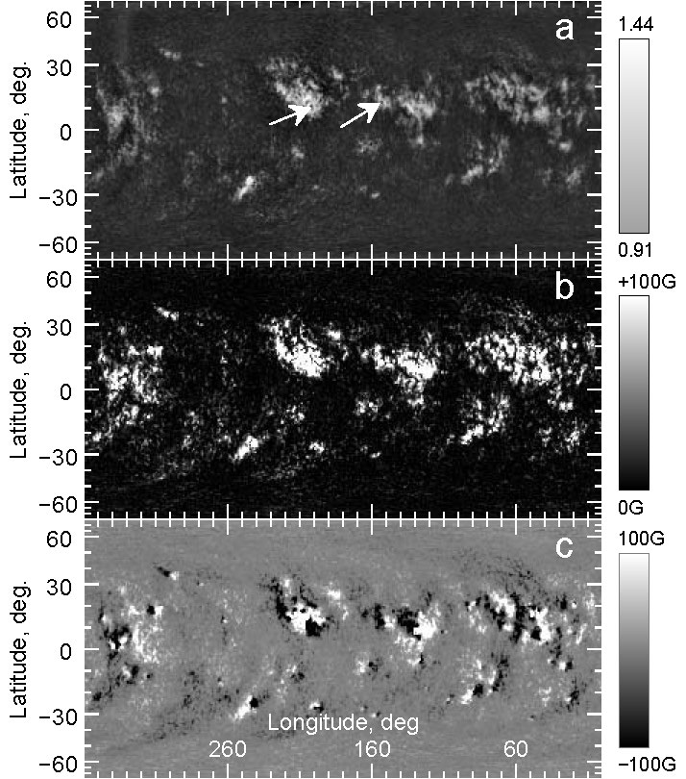
Ca II K synoptic map
Unsigned magnetogram
Signed magnetogram
Pevtsov et al (2016)

Slide 7
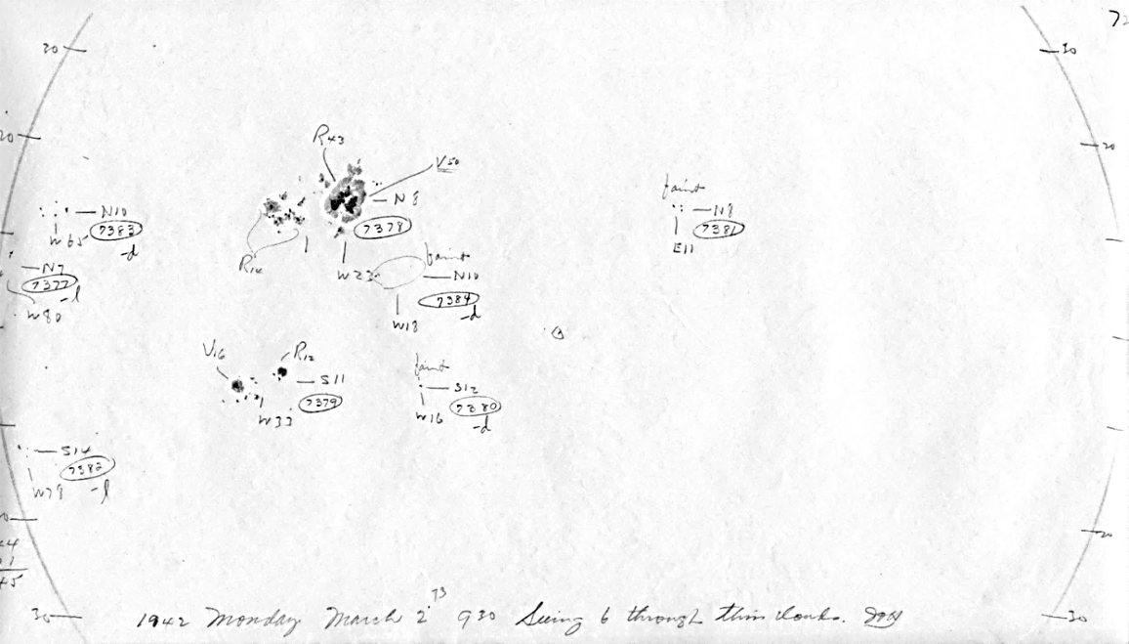
How about polarity of magnetic field ?
MWO Sunspot Field Strength Measurements (1917-present)

Slide 8
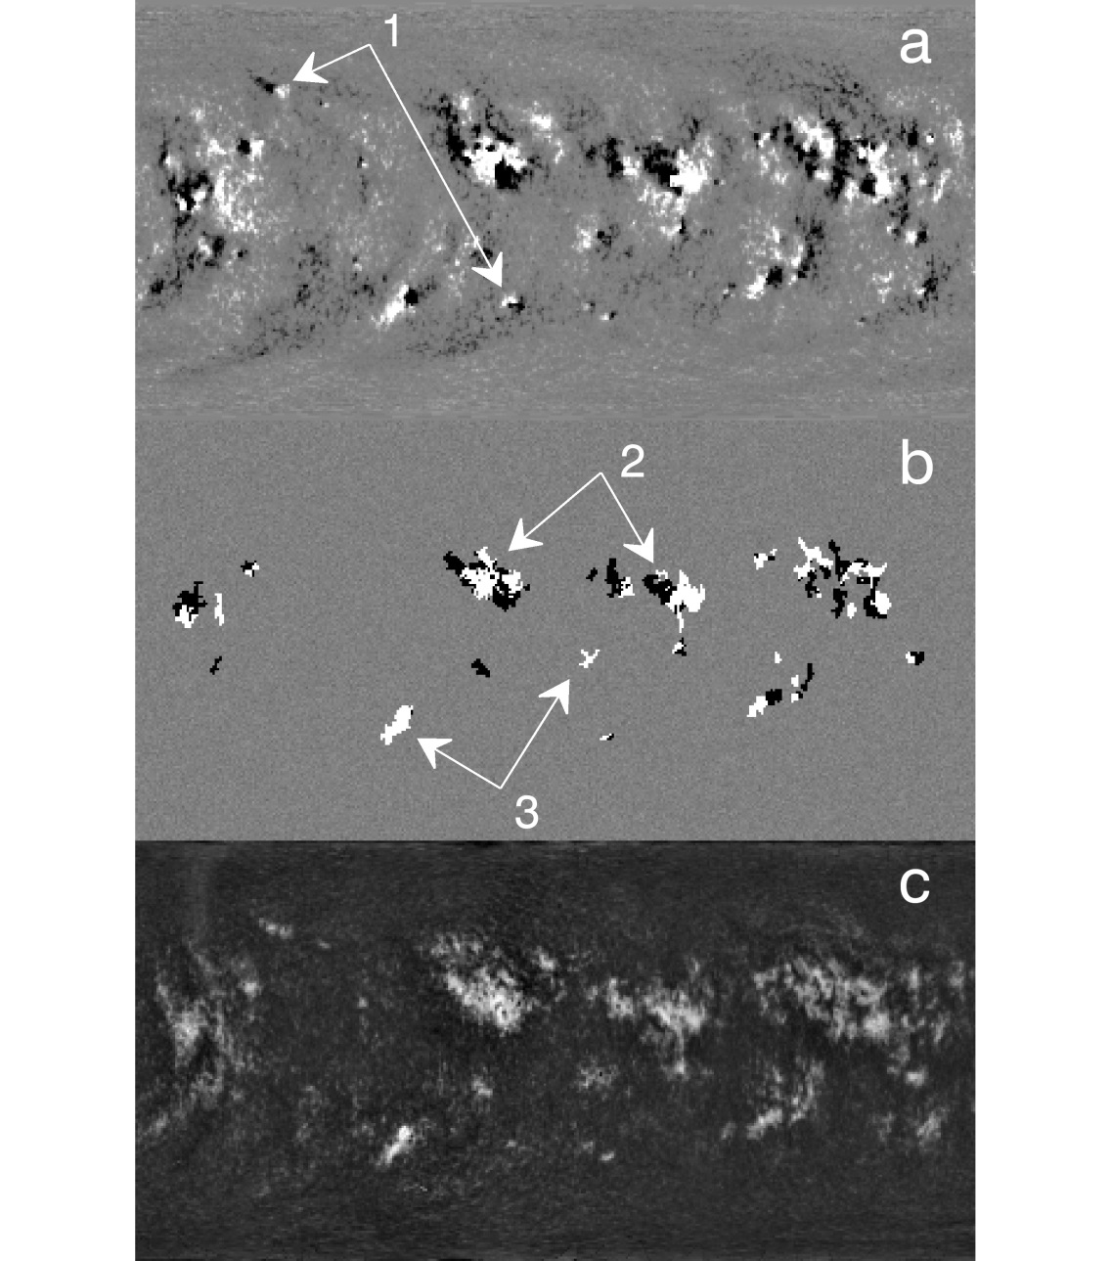
Pseudo-Magnetograms (K-line + sunspot polarity measurements)
- missing
- good match
- only one polarity
Overall – 80% agreement in pixels polarity
Pevtsov et al (2016)

Slide 9
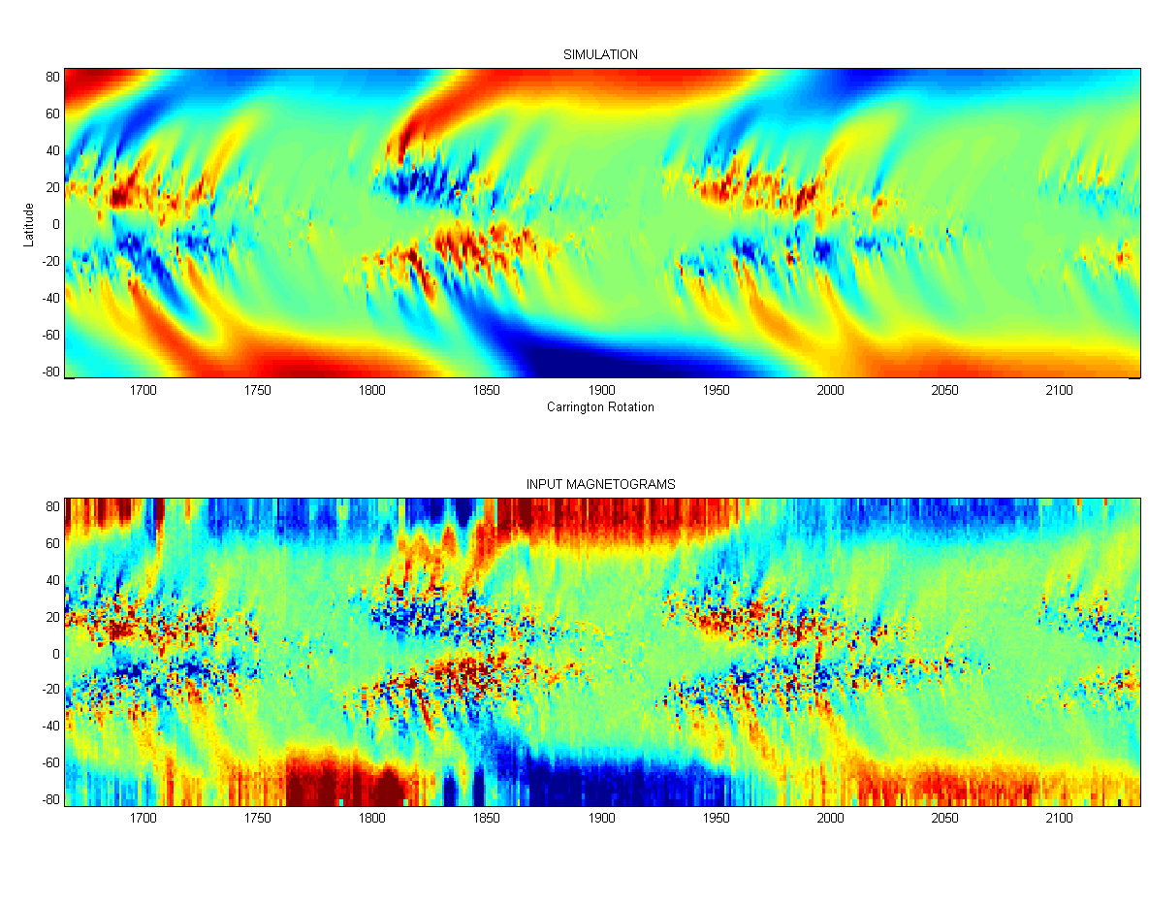
Surface Flux-Transport Modeling
Simulations based on historical data
“Evolve” magnetic field:
Diffusion
Meridional flow
Differential rotation
Observations from KPVT
Virtanen et al (2017)

Slide 10
Even in the modern age of high resolution imaging and sophisticated modeling, historical data could be extremely useful for studies of various physical phenomena on the Sun

Slide 11
But…
Value of synoptic data is under-appreciated
Bibliometrics is increasingly used as a measure of importance (and funding distribution)
There is no commercial value in solar data (and derived products do not want sharing the costs).
Funding is declining (also, there are structural changes in funding schemes).

Slide 12
Solar Observatories Around the Globe
NSO/GONG+SOLIS
HAO/MLSO
NJIT/BBSO
Stanford/WSO
CSUN/SFO
UCLA/MWO
map
https://www.iau.org/science/scientific_bodies/working_groups/255/

Slide 13
Future Plans
SPRING network (possible replacement for GONG): 4-6 sites, 1-m telescopes, SOLIS-type mount, multi-wavelength helioseismology and vector magnetography

Slide 14
Some current issues
3-5 year funding cycle is too short for synoptic programs
Strong emphasis on immediate scientific return (most in US are grants funded)
Lack of long-term planning (no well-defined goals, diminishing funding, aging facilities).
Long-term datasets are often ad hoc collections.
Lack of coordination between national programs/ observatories (non-uniform/ duplicate data).
No critical evaluation (what do we need to observe, what is missing etc).
Data preservation

Slide 15
What to do with synoptic data?
Current modus operandi: host institute “takes care of its own data”
Data may be hard to find and access (FTP, “ask for data”, VSO).
No clear long-term plan for data preservation (loss of data at the end of project, outdated file formats).
Examples: MWO (CaK), NSO (coronal data, Kitt Peak spectral line profiles, sun-as-a-star, solar disk center (W. Livingston data), SP K-line monitor spectra), HK MWO stellar dataset, observations from Haleakala Solar Observatory/UH
NOAA – emphasizes space weather, lacks sufficient

Slide 16
Historical orphan data
Paper (hand drawings, computer printouts/rolls, observing logs)
Photographic data (film, plates)
Electronic records (tapes, disks, CDs etc).

Slide 17
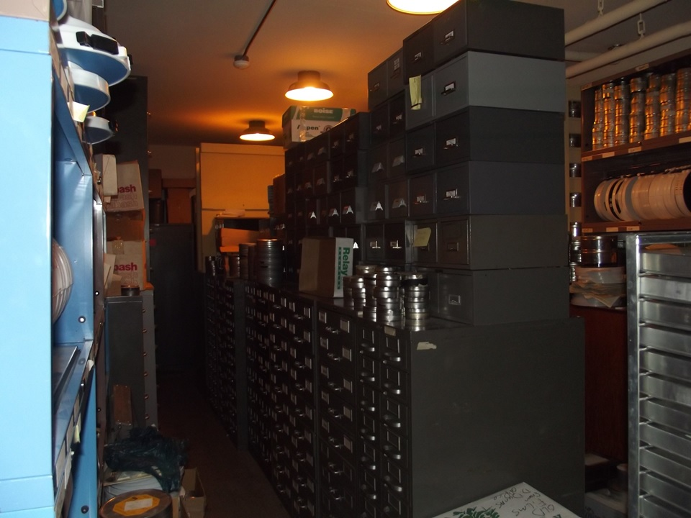
NSO Photo-archive in 2015
25 ft
12 ft

Slide 18
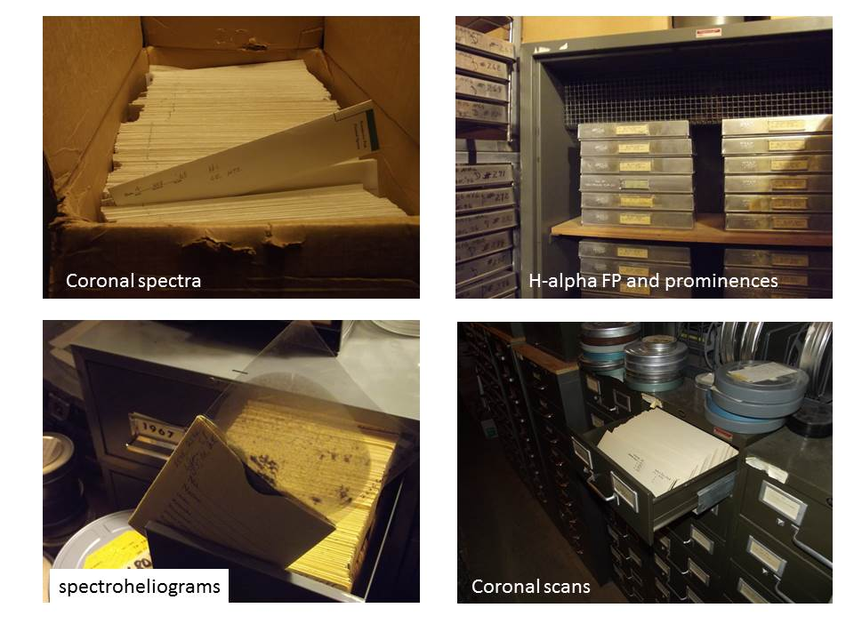

Slide 19
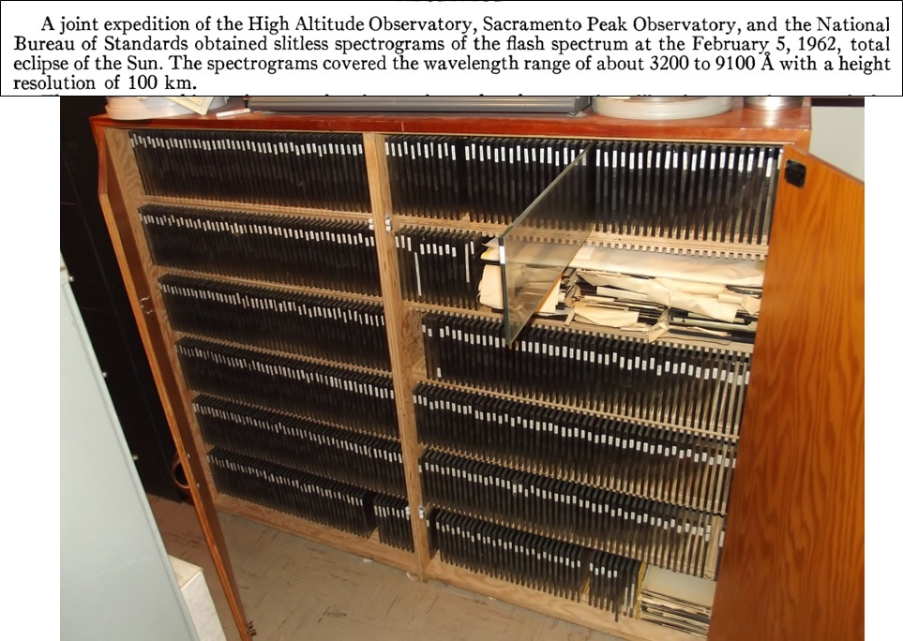

Slide 20
Lack of Dedicated Funding for Data preservation
Converting to electronic format (scanning, creating metadata): ex. BBSO and NSO flare patrol (late-1950th-2002), sunspot drawings (NSO and MWO), spectroheliograms
No funding for follow-up work (meta-data, calibration)

Slide 21
What needs to be done (observations)
Critical evaluation of synoptic observations
Develop plan for replacing instruments for maintaining critical datasets (set of automated stations?)
Establish new funding models (longer funding periods for synoptic programs, inter-agencies funding)
Other “working” aspects (e.g., format, version of data reduction, clear description of data and reduction).

Slide 22
What needs to be done (data preservation)
Create comprehensive list of data to preserve and identify funding sources
Develop clear path for preserving the data and identify responsible parties: e.g., NASA-like (1) instrument archive, (2) long-term archive, (3) final storage
Realistic long-term data preservation plans must be required for all future synoptic programs

Slide 23
What needs to be done (international collaboration)
Leverage international collaboration (share expenses and responsibilities, prevent duplication, data sharing policies/international agreements)
Ensure strong support from international societies (IAU, SCOSTEP/ICSU, WMO etc).

Slide 24
Recent developments
Trying “joining forces” with astronomy community on data preservation
Starting discussions on closer international collaborations (meeting in Goettingen, white paper for U.N. presentation).

Slide 25
How synoptic observations can/will shape new frontiers of discovery
Data collected now enable future research (Galileo vs. space weather effects)
Science: critical knowledge about long-term changes in sun’s activity (as a natural system, e.g., what changes occur prior to major shifts in activity levels, how solar dynamo recovers from grand minima)
Technology: there might be an opportunity for developing durable, reliable, autonomous systems that would benefit the long-term synoptic observation programs.

Slide 26
Existing resources
NSF Earthcube, NSF RFI on existing and future scientific community needs for mid-scale research infrastructure.
Several international/national grassroots initiatives → “join forces” with astronomy community on data preservation
Support from international societies (IAU, SCOSTEP, etc).
New approaches for improving the data recognition (DOI, DataCite, CrossRef, adopt (?) USGS practice for their stations).
Three worldwide organizations dedicated to science data: World Data System (WDS), Committee on Data for Science and Technology (CODATA), Research Data Alliance (RDA).

Slide 27
https://www.iau.org/science/scientific_bodies/working_groups/255/
http://www.iau.org/science/scientific_bodies/working_groups/255/

Slide 28
Brief Description of WG
WG was created at the end of 2011-early 2012; in 2015 after the IAU restructuring, it became “Inter-Division B and E WG on Coordination of Synoptic Observations of the Sun” (functional).
Co-Chairs: Frederic Clette (Belgium) and Alexei Pevtsov (USA)
WG web pages:
http://www.iau.org/science/scientific_bodies/working_groups/255/
http://www.nso.edu/IAU-Com12 - direct link to group page

Slide 29
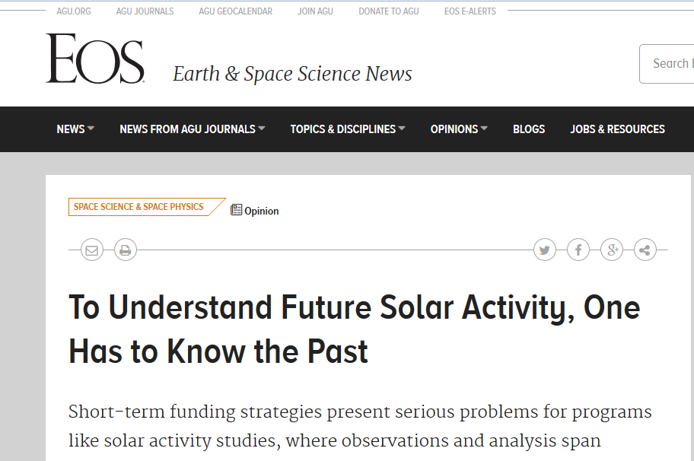
https://eos.org/opinions/to-understand-future-solar-activity-one-has-to-know-the-past

Slide 30
Thank you for your attention

