Slide 1
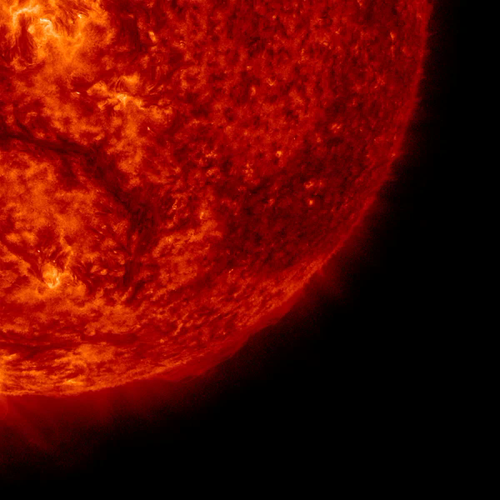

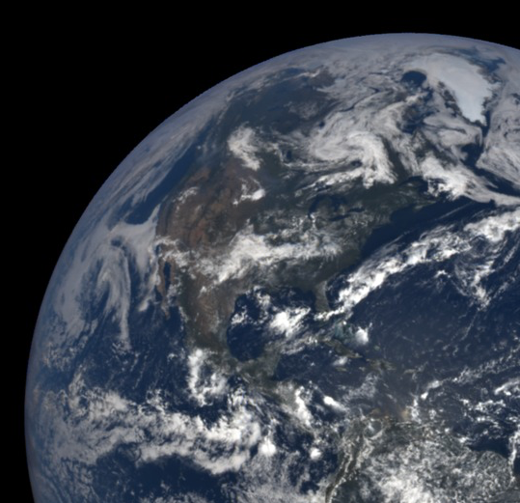
Galileo Solar Space Telescope | GSST
Development of Instrumentation for Solar Observations at the Brazilian National Institute for Space Research (INPE)
Understanding the Origin of Solar Activity and its Impact on Geospace.
Observations of the Solar Atmosphere, Magnetic Field and Irradiance
Notes:
Incluir o Símbolo da AEB.

Slide 2

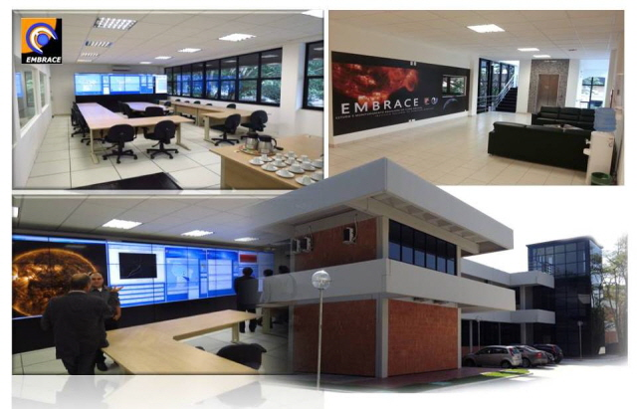

National Institute for Space Research
Research and Development:
Space and Atmospheric Sciences
Earth Observation
Space Engineering and Technology
Integration and Testing Laboratory
Satellite Tracking and Control
Associated Laboratories:
  Sensors and Materials, Plasma, Computing and
  Applied Mathematics, Combustion and Propulsion.

Slide 3

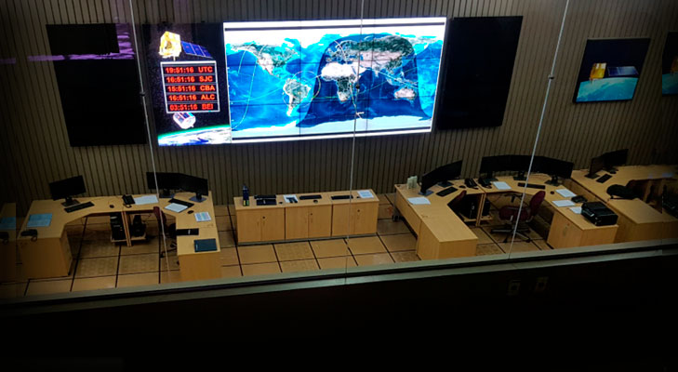
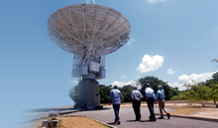
National Institute for Space Research
Research and Development:
Space and Atmospheric Sciences
Earth Observation
Space Engineering and Technology
Integration and Testing Laboratory
Satellite Tracking and Control
Associated Laboratories:
  Sensors and Materials, Plasma, Computing and
  Applied Mathematics, Combustion and Propulsion.

Slide 4
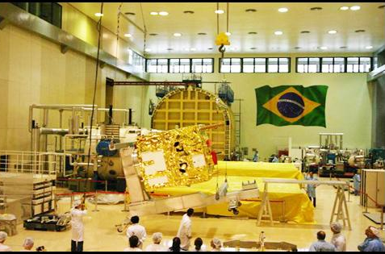
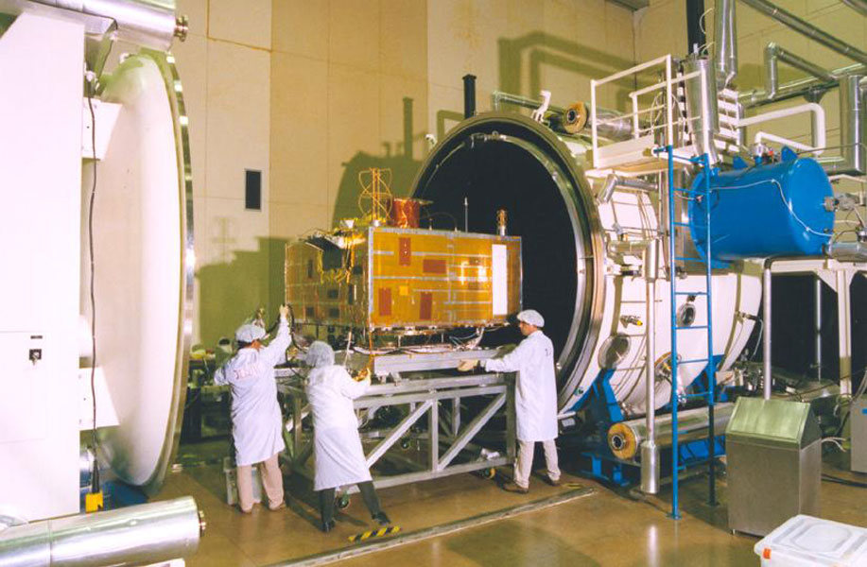
National Institute for Space Research
Research and Development:
Space and Atmospheric Sciences
Earth Observation
Space Engineering and Technology
Integration and Testing Laboratory
Satellite Tracking and Control
Associated Laboratories:
  Sensors and Materials, Plasma, Computing and
  Applied Mathematics, Combustion and Propulsion.

Slide 5
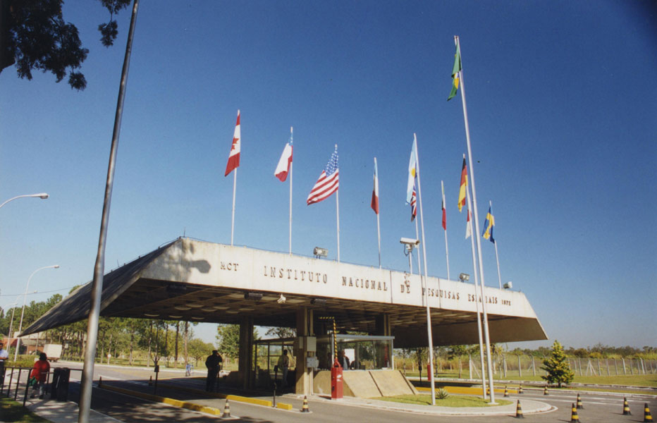
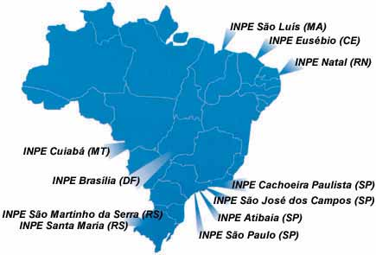
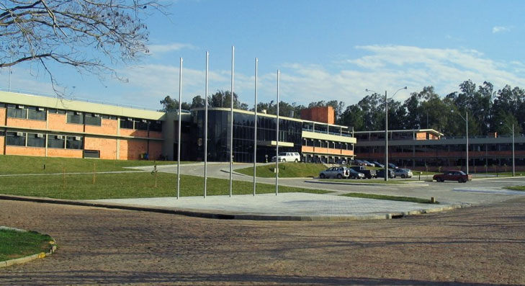
Instituto Nacional de Pesquisas Espaciais

Slide 6
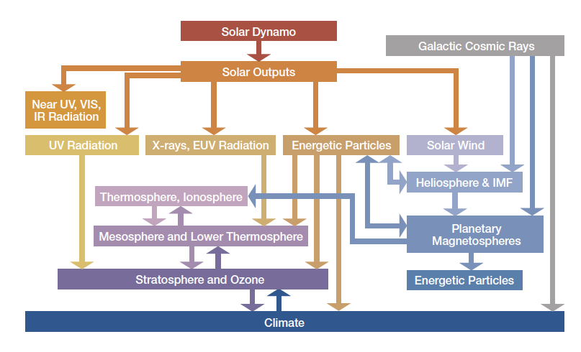
Scientific Motivation: Investigate the Links Between the Solar Surface, Corona, and Inner Heliosphere
NASA Roadmap

Slide 7
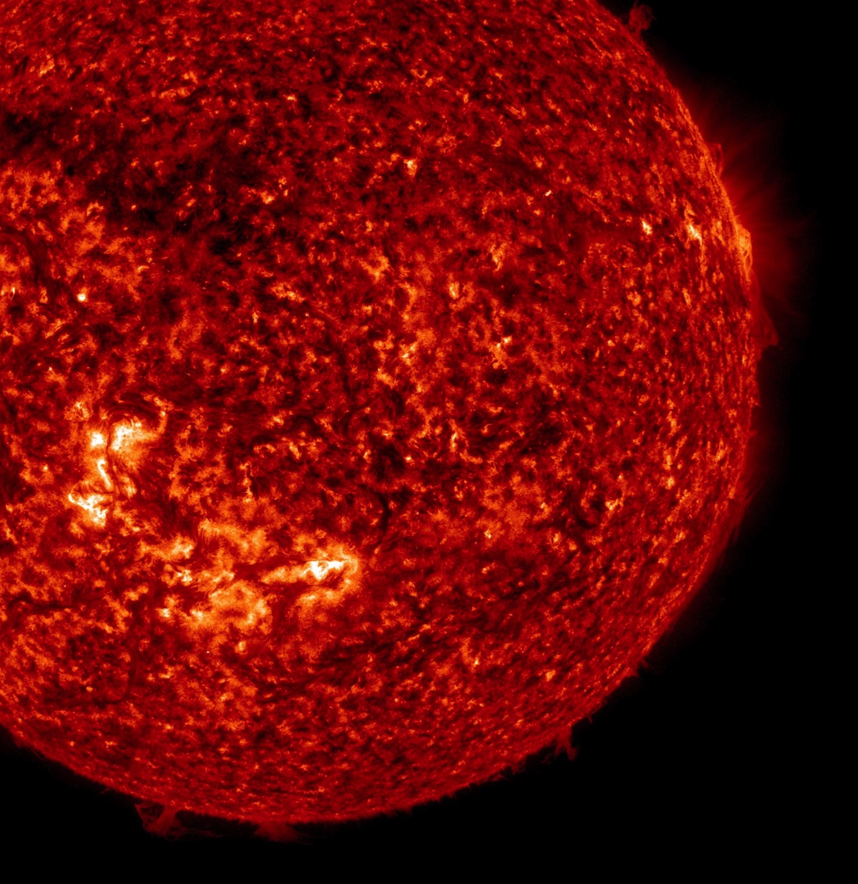
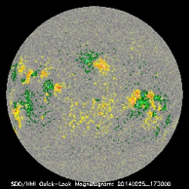
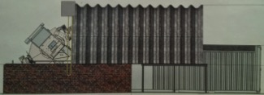
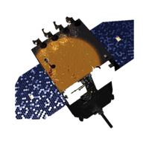
Project Planning
2014
2015
2016
2017
2018
2019
2020
2021
2023
2022
Development of the Proof of Concept
Magnetograph
Ground Based Solar Telescope
Galileo Solar Space Telescope
Out-of-the-ecliptic Solar Observatory
Understanding the Origin of Solar Activity and its Impact on Geospace.
Out-of-the-Ecliptic Observations of the Solar Atmosphere, Magnetic Field and Irradiance

Slide 8
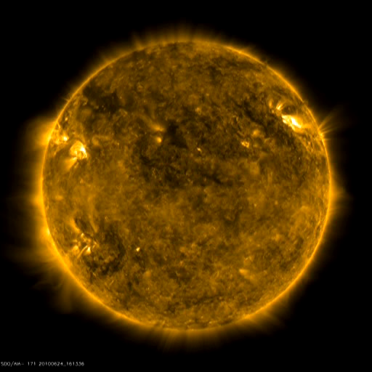
Goals
Build a Visible and UV light imagers and magnetographs for solar observations.
HMI/AIA/SDO-NASA

Slide 9
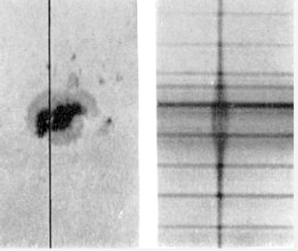
Concept
Wavelength Scan
Polarization State Scan
Inversion Models
Stokes Parameters (I,Q,U,V)
Telescope
Magnetic Field Estimate
Sensor (Cameras)
Physical process based on the Zeeman effect.
The keypoint of polarimetry is breaking some symmetry. When an asymmetry is induced - in the magnetic field- polarization is produced.
Norman Lockyer, 1866; Hale, 1901
Notes:
Actually measured are polarization degrees across magnetically sensitive spectral lines, e.g., the line pair Fe i 6302.5 and 6301.5 Å as used on Hinode/SOT (see Lites et al., 2007) or Fe I 6173.3 Å as used on SDO/HMI (see Schou et al., 2012).

Slide 10
Project Planning
2014
2015
2016
2017
2018
2019
2020
2021
2023
2022
Development of the Proof of Concept
Magnetograph
Ground Based Solar Telescope
Galileo Solar Space Telescope
Out-of-the-ecliptic Solar Observatory
Understanding the Origin of Solar Activity and its Impact on Geospace.
Out-of-the-Ecliptic Observations of the Solar Atmosphere, Magnetic Field and Irradiance

Slide 11
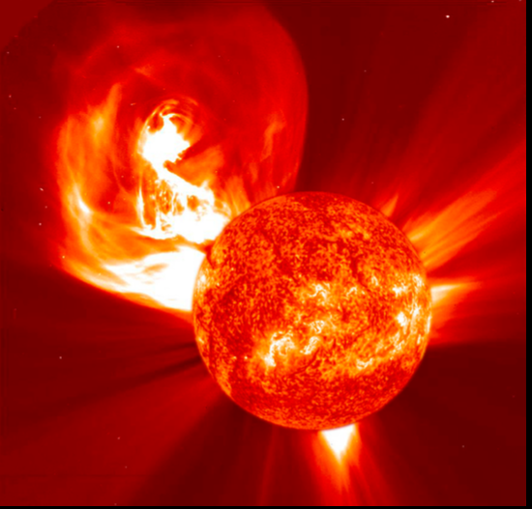
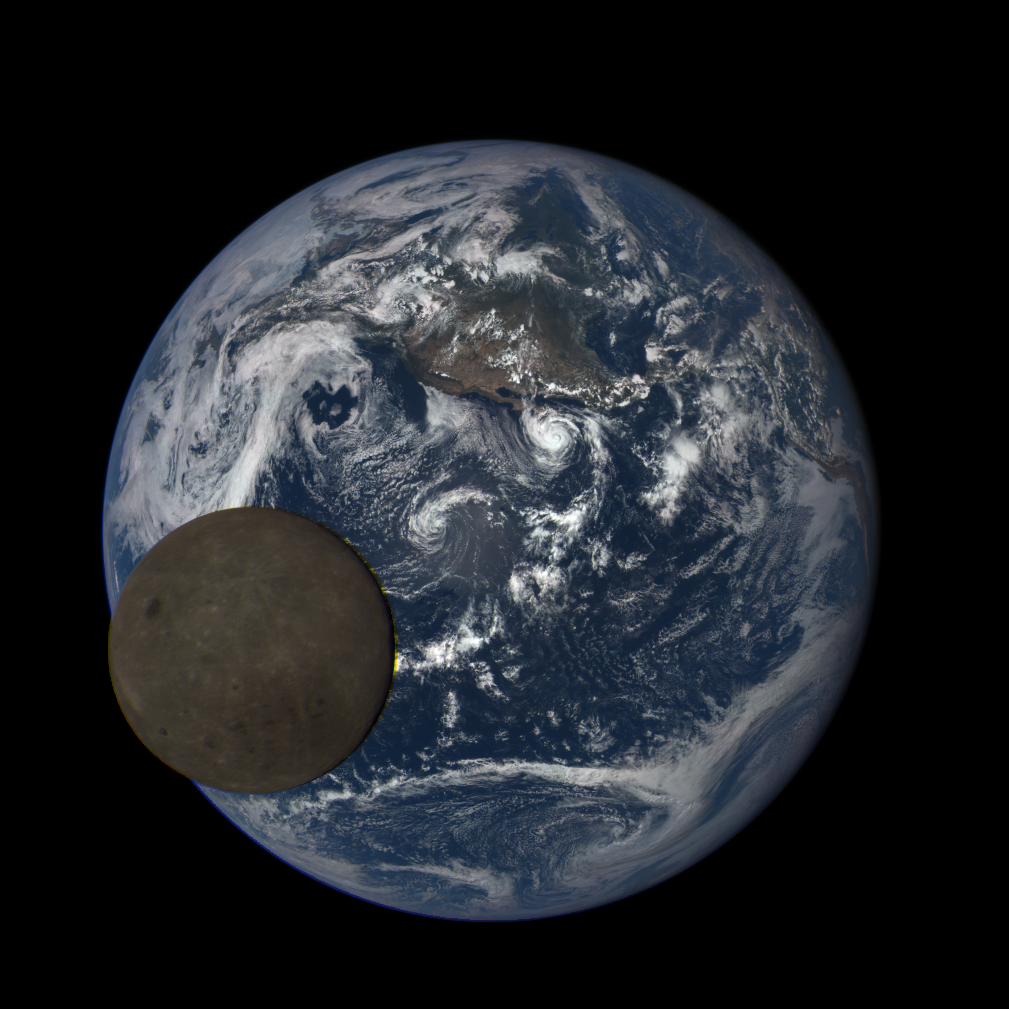
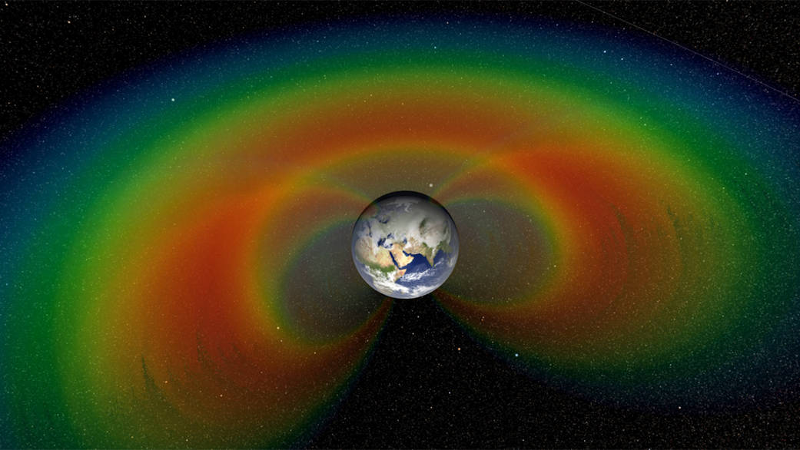
GSST - Scientific Objectives
1. Understand the evolution of the magnetic structures of the outer layer of the Sun
2. Understand the Sun's influence on Earth's Climate
3. Understand the Sun's influence on the Geospace

Slide 12
GSST - Scientific Objectives
1. Understand the evolution of the magnetic structures of the outer layer of the Sun
1.1 Fundamental plasma processes.
1.2 Heating of the outer layers (Chromosphere to Corona)
1.3 Solar Dynamo (Global and local)

Slide 13
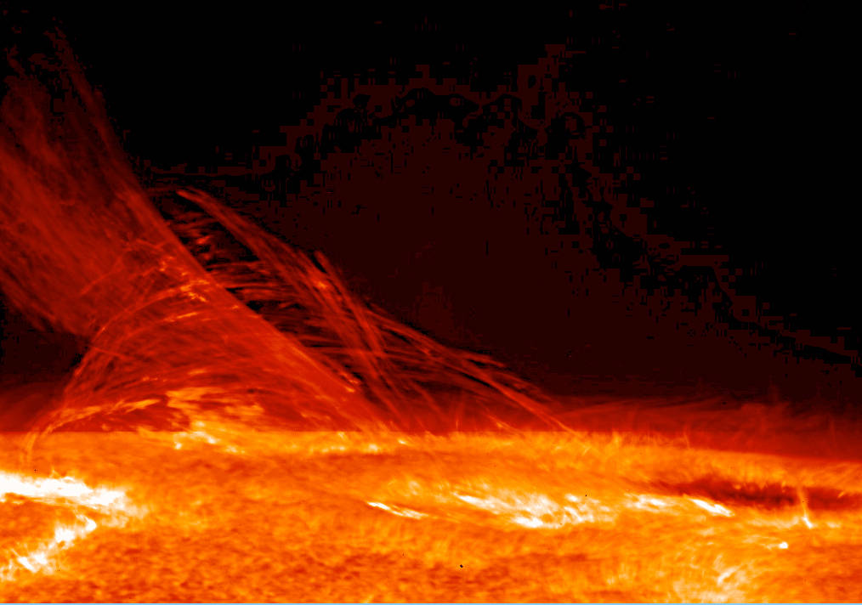
GSST - Scientific Objectives
1. Understand the evolution of the magnetic structures of the outer layer of the Sun
Scientific Observations Required
1.1.1 High spatial and temporal resolution observations of the magnetic structure of the photosphere, chromosphere, transition region and corona through the solar cycle.
1.1 Fundamental plasma processes.
1.2 Heating of the outer layers (Chromosphere to Corona)

Slide 14
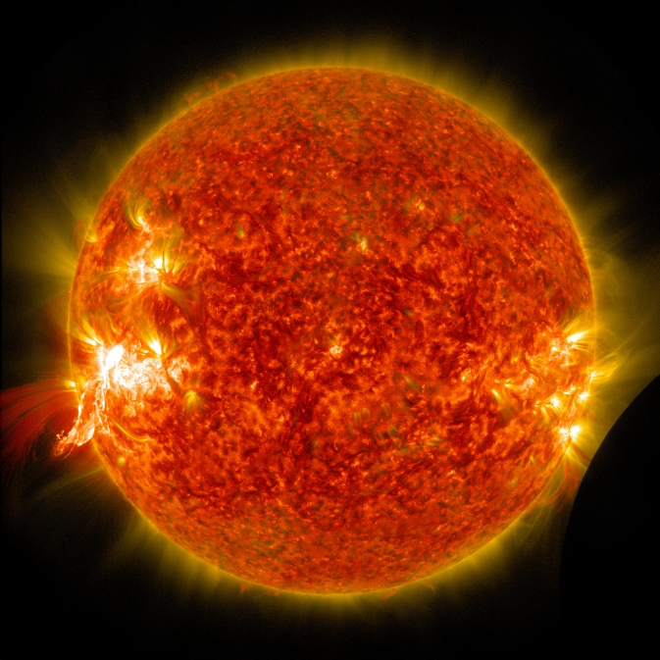
GSST - Scientific Objectives
1. Understand the evolution of the magnetic structures of the outer layer of the Sun
1.3 Solar Dynamo (Global and local)
Scientific Observations Required
1.3.1 Wide view observations of the sun the magnetic structure of the photosphere, chromosphere, transition region and corona through the solar cycle.

Slide 15
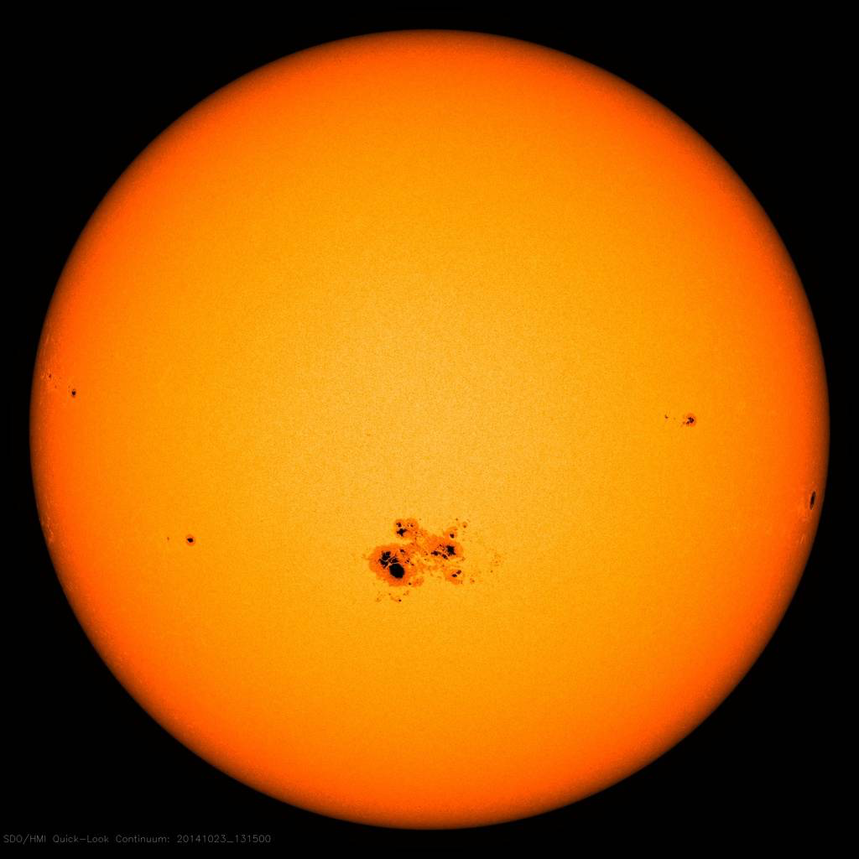

GSST - Scientific Objectives
2. Understand the Sun's influence on Earth's Climate
2.1 Effects of the magnetic structure of the outer layers of the Sun on the evolution of Earth's Atmosphere
Scientific Observations Required
2.1.1 Observation of the variability of the total solar irradiance.
All other sources ΔS=0.13 W/m²
S=1361 W/m²

Slide 16
GSST - Scientific Objectives
3. Understand the Sun's influence on the Geospace
3.1 Effects observed inner magnetosphere due to solar structures
3.1.1 Relativistic electron flux dynamics in the outer radiation belt
Scientific Observations Required
3.1.2 Relativistic proton flux dynamics in the inner radiation belt
3.1.3 Energy spectra of the particles
3.1.4 Ambient magnetic field vector variations

Slide 17
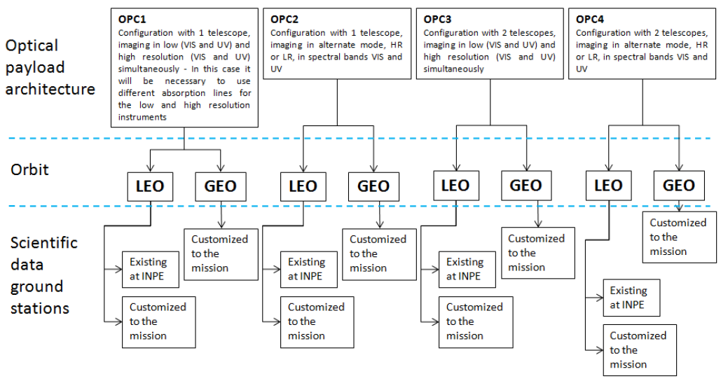
GSST – System Drivers and critical requirements identification
Preliminary trade tree for the system drivers
Scientific Observations Required

Slide 18
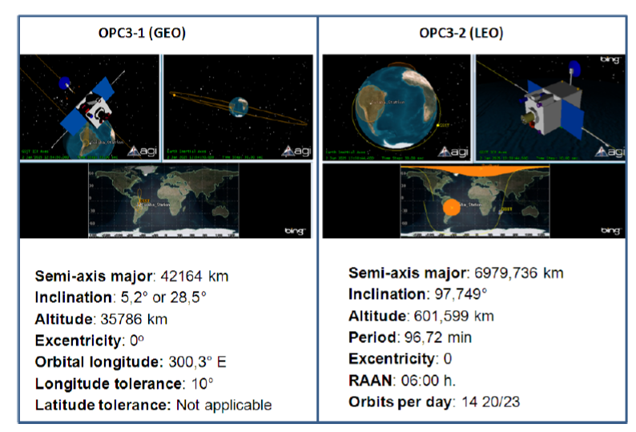
GSST – Summary of orbit parameters for OPC3-1 and OPC3-2.
Scientific Observations Required

Slide 19
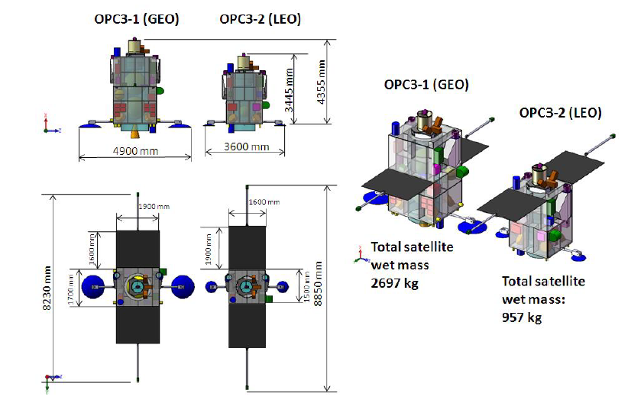
GSST – Satellite layout concepts for OPC3-1 and OPC3-2
Scientific Observations Required

Slide 20
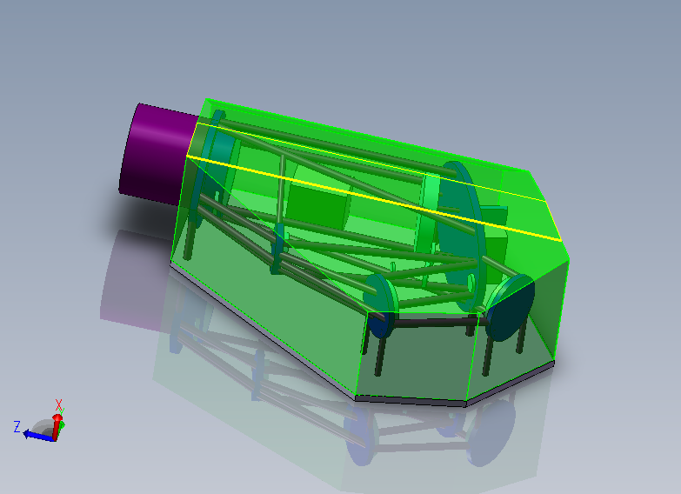
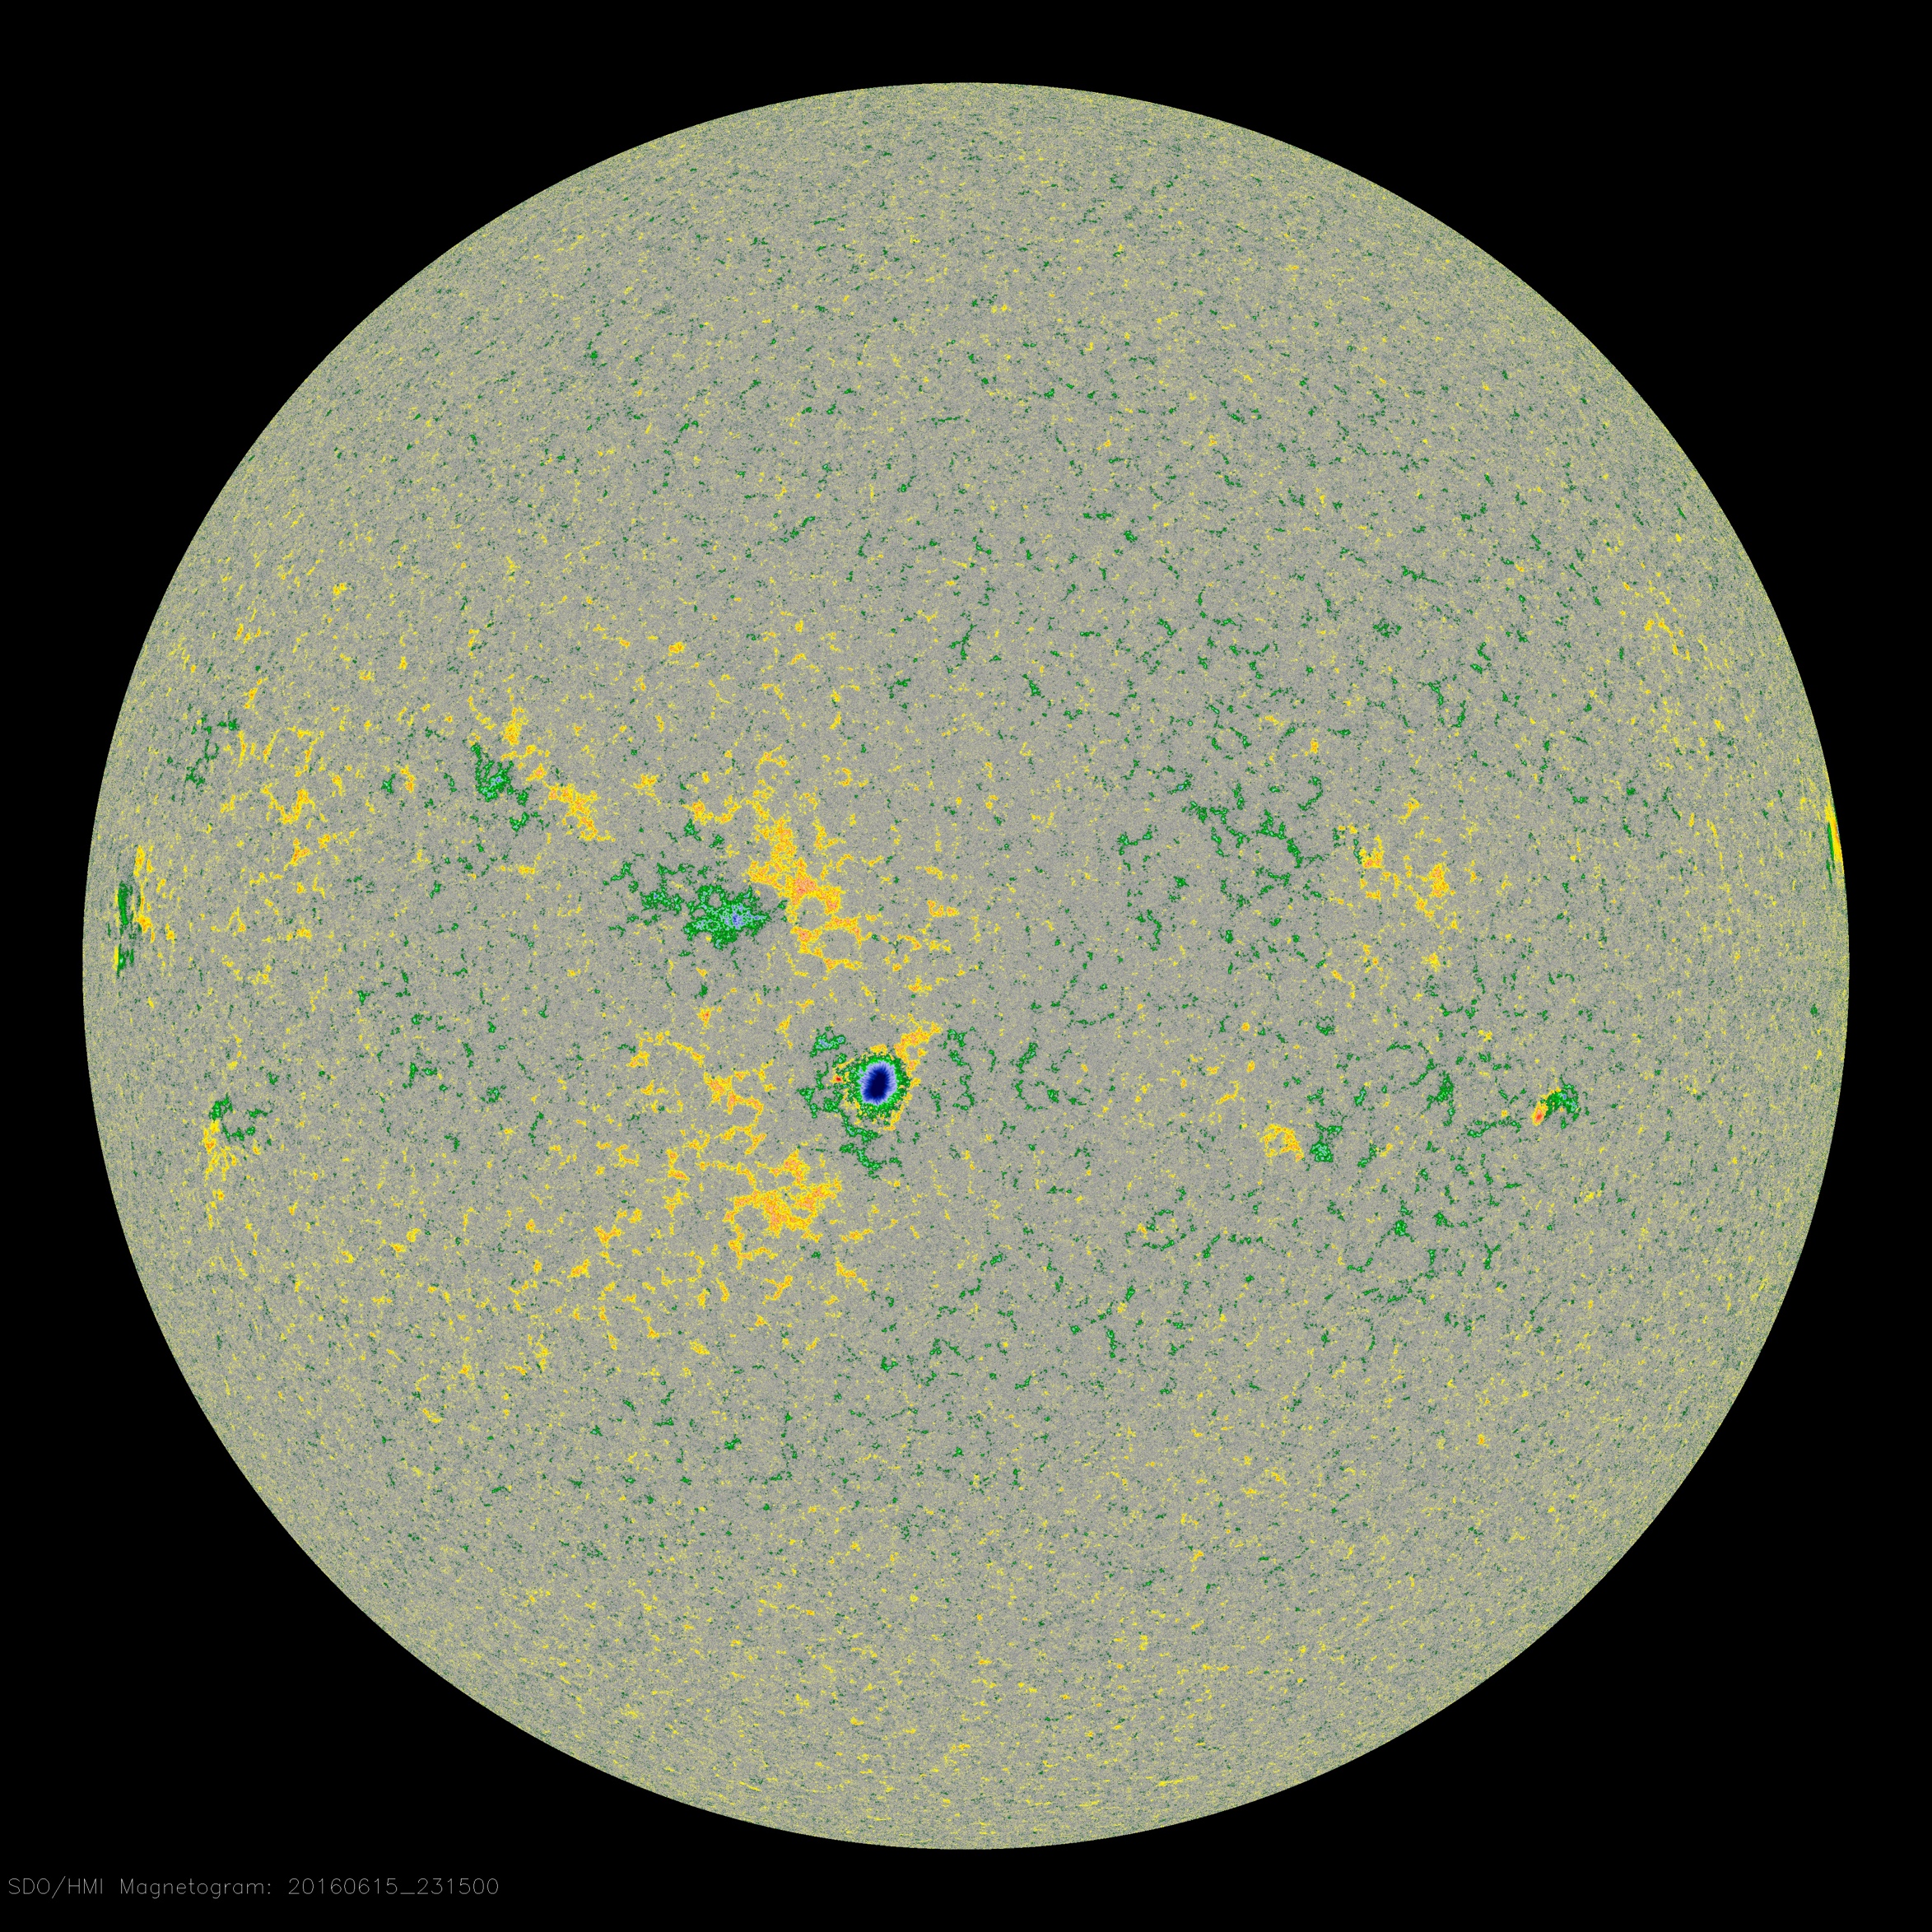
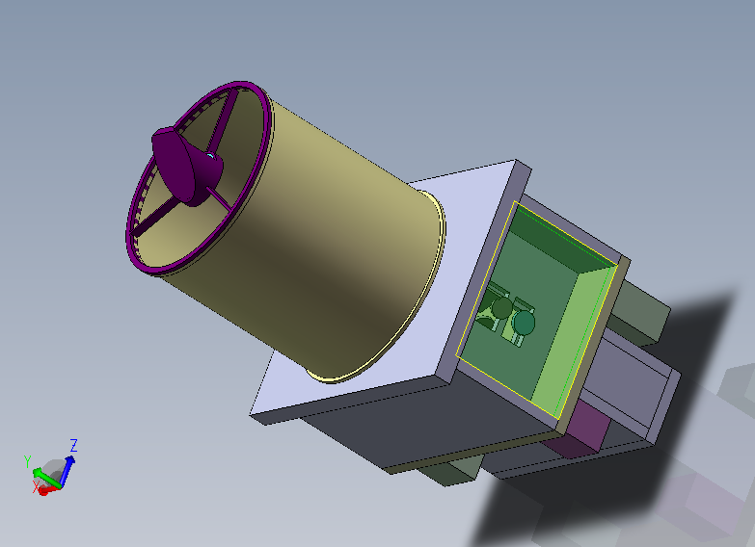
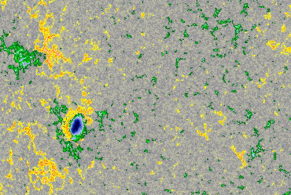
GSST – Imaging payloads
Scientific Observations Required

Slide 21
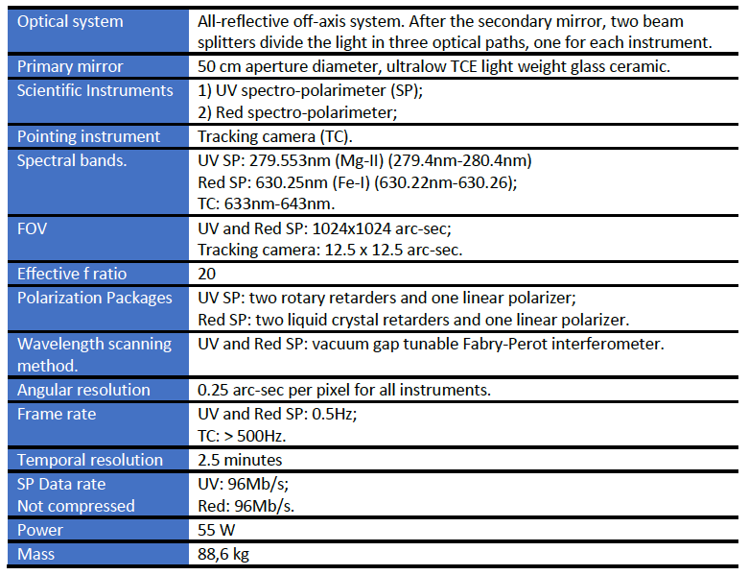
GSST – Approach for the Imaging payloads
Main characteristics of the HR camera.
Scientific Observations Required

Slide 22
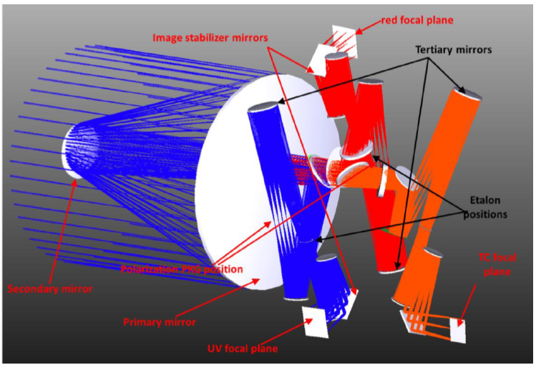
GSST – Approach for the Imaging payloads
Main characteristics of the HR camera.
Scientific Observations Required

Slide 23
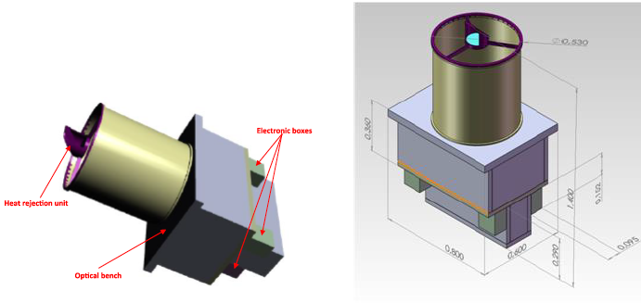
GSST – Approach for the Imaging payloads
Main characteristics of the HR camera.
Scientific Observations Required

Slide 24
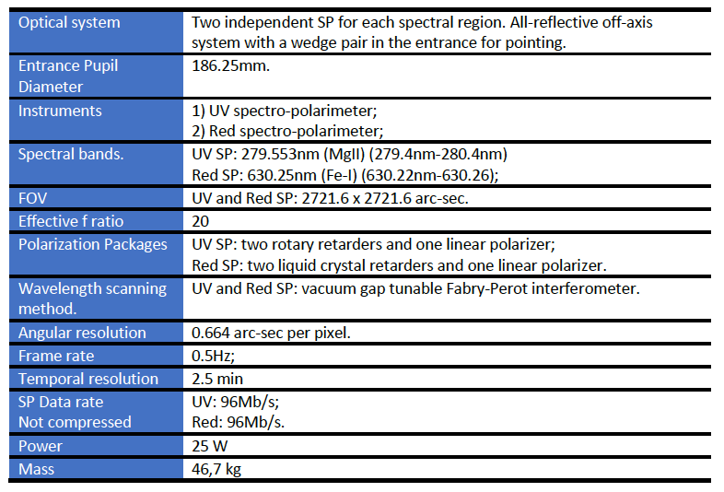
GSST – Approach for the Imaging payloads
Main characteristics of the Full Disk camera.
Scientific Observations Required

Slide 25
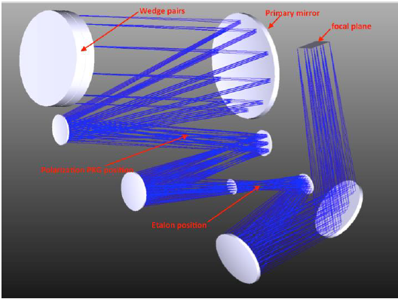
GSST – Approach for the Imaging payloads
Main characteristics of the Full Disk camera.
Scientific Observations Required

Slide 26
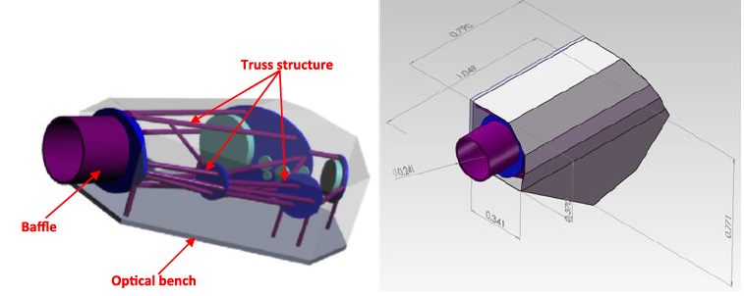
GSST – Approach for the Imaging payloads
Main characteristics of the Full Disk camera.
Scientific Observations Required

Slide 27

Galileo Solar Space Telescope | GSST
Development of Instrumentation for Solar Observations at the Brazilian National Institute for Space Research (INPE)
Understanding the Origin of Solar Activity and its Impact on Geospace.
Observations of the Solar Atmosphere, Magnetic Field and Irradiance
Notes:
Incluir o Símbolo da AEB.

Slide 28
Project Planning
2014
2015
2016
2017
2018
2019
2020
2021
2023
2022
Development of the Proof of Concept
Magnetograph
Ground Based Solar Telescope
Galileo Solar Space Telescope
Out-of-the-ecliptic Solar Observatory
Understanding the Origin of Solar Activity and its Impact on Geospace.
Out-of-the-Ecliptic Observations of the Solar Atmosphere, Magnetic Field and Irradiance

Slide 29
Concept: Optical Design
Instrument Performance / Dynamic Range
 | INPE | HMI/SDO | MDI/SOHO
Parameter | Value/Range | Value/Range | Value/Range
Spatial resolution** | 1 arcsec | 1 arcsec (0”5) | 4arcsec (1.98”)
Cadence** | 90 s | 90 s 45 & 720 s | 60 s
Spectral Range | 6302.5 Å± 3 Å | 6173 Å± Å | 6767.8Å mÅ***
Spectral Bandwidth | 160 mÅ | 76 mÅ (68.8 mA x 6 =412 mA) | 95 m Å (75.6mA, each point). FWHM =159-169 mA. S.E. Evans, 1998).
B_{LOS} | +-3.5 kG | ± 4 kG | ± 3.0-3.5 kG
B_{TRA} | +-3.5 kG | ± 2.5 kG | ---
V_{LOS} (long-term) | NA |  | 0.1 km/s (Beck J. G, 1998)
V_{LOS} (instantaneous) | ± 10 m s⁻¹ | ± 6 m s⁻¹
Notes:
Actually measured are polarization degrees across magnetically sensitive spectral lines, e.g., the line pair Fe i 6302.5 and 6301.5 Å as used on Hinode/SOT (see Lites et al., 2007) or Fe I 6173.3 Å as used on SDO/HMI (see Schou et al., 2012).

Slide 30
Concept: Optical Design
Wavelength Scan
Polarization State Scan
Inversion Models
Stokes Parameters (I,Q,U,V)
Telescope
Magnetic Field Estimate
Sensor (Cameras)
Notes:
Actually measured are polarization degrees across magnetically sensitive spectral lines, e.g., the line pair Fe i 6302.5 and 6301.5 Å as used on Hinode/SOT (see Lites et al., 2007) or Fe I 6173.3 Å as used on SDO/HMI (see Schou et al., 2012).

Slide 31
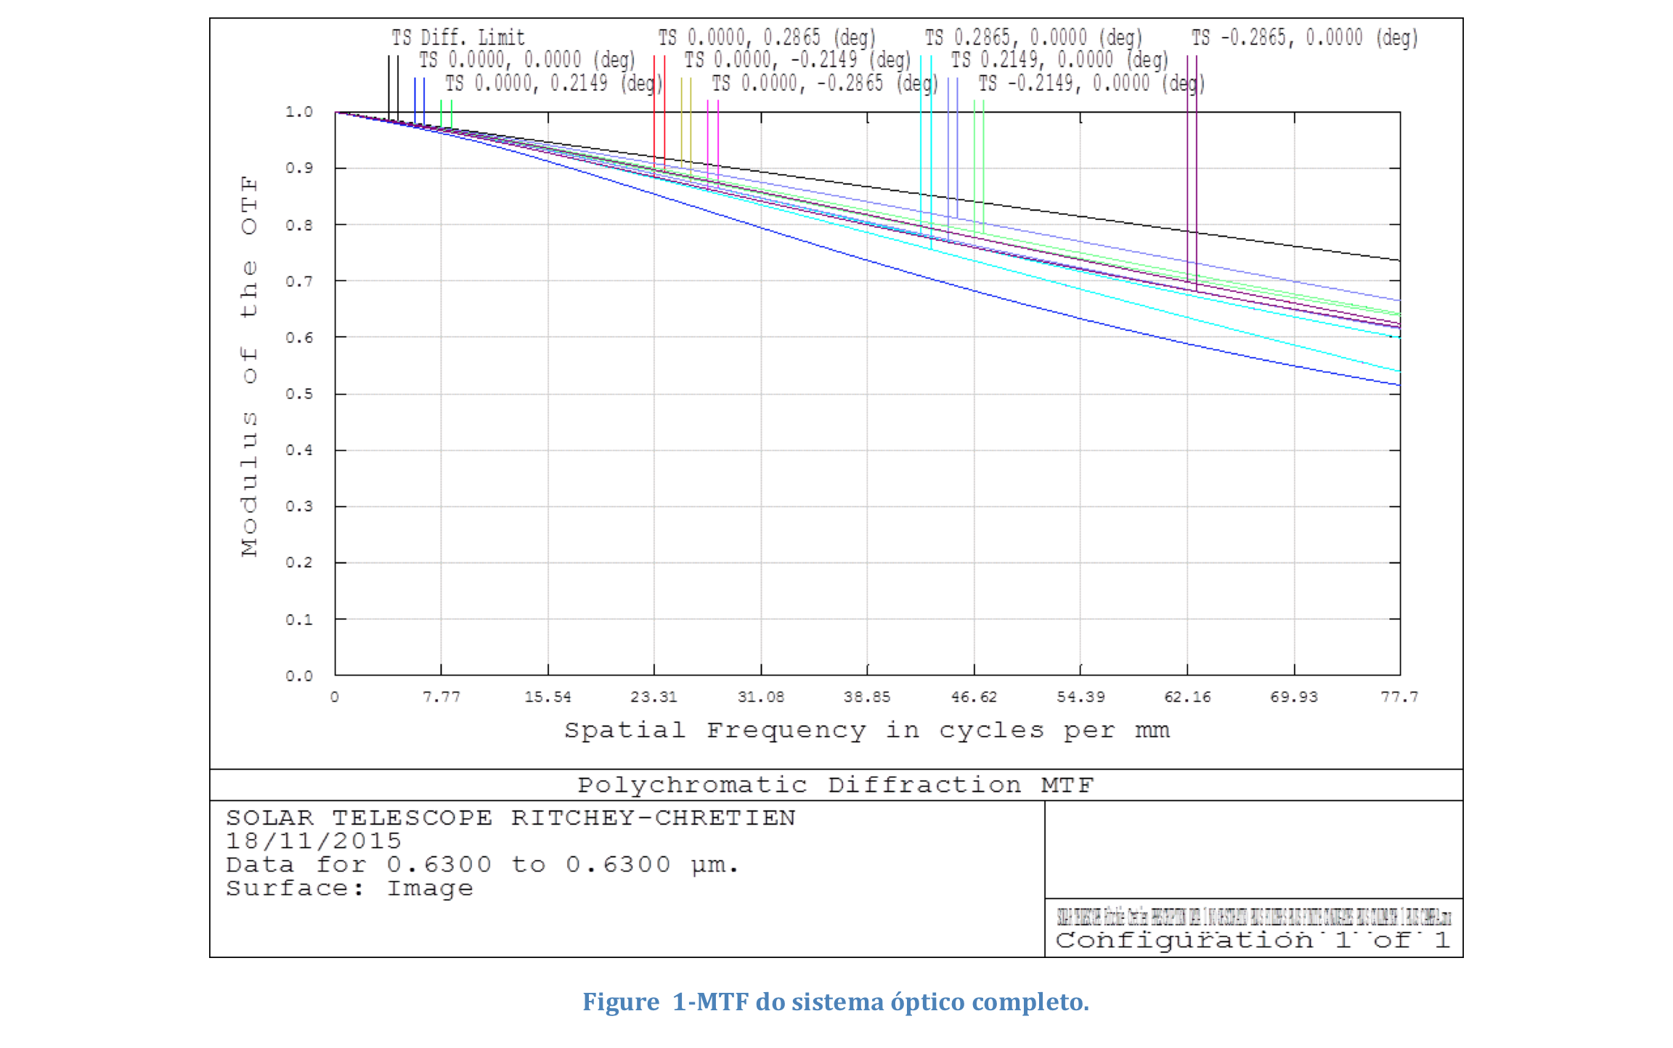
Concept: Optical Design
Notes:
Actually measured are polarization degrees across magnetically sensitive spectral lines, e.g., the line pair Fe i 6302.5 and 6301.5 Å as used on Hinode/SOT (see Lites et al., 2007) or Fe I 6173.3 Å as used on SDO/HMI (see Schou et al., 2012).

Slide 32
Proof of Concept: Optical Design
Proof of Concept Model Philosophy:
Similarity with the final instrument.
Use COTS as much as possible.
Much smaller instrument
Fast and easy implement and debug.
Notes:
Actually measured are polarization degrees across magnetically sensitive spectral lines, e.g., the line pair Fe i 6302.5 and 6301.5 Å as used on Hinode/SOT (see Lites et al., 2007) or Fe I 6173.3 Å as used on SDO/HMI (see Schou et al., 2012).

Slide 33
Proof of Concept: Optical Design
Design of IO-1 and IO-2.

Slide 34
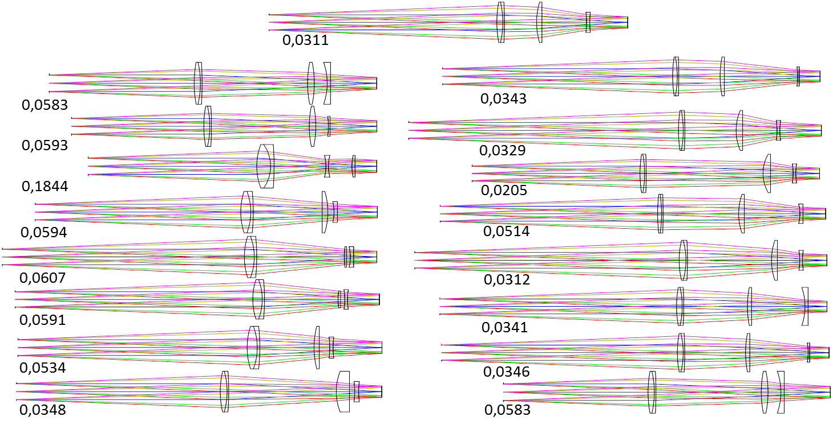
Proof of Concept: Optical Design
Design of IO-3 and IO-4.

Slide 35
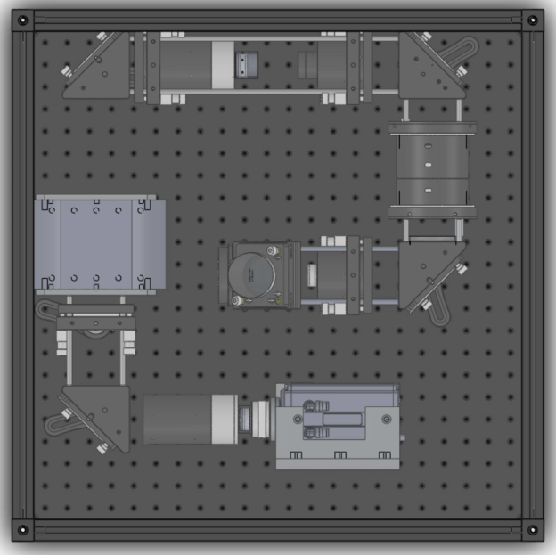
Proof of Concept: Optical Design
Proof of Concept Model Philosophy:
Similarity with the final instrument.
Use COTS as much as possible.
Much smaller instrument
Fast and easy implement and debug.
Wavelength Scan
Polarization State Scan
Inversion Models
Stokes Parameters (I,Q,U,V)
Telescope
Magnetic Field Estimate
Sensor (Cameras)
Notes:
Actually measured are polarization degrees across magnetically sensitive spectral lines, e.g., the line pair Fe i 6302.5 and 6301.5 Å as used on Hinode/SOT (see Lites et al., 2007) or Fe I 6173.3 Å as used on SDO/HMI (see Schou et al., 2012).

Slide 36
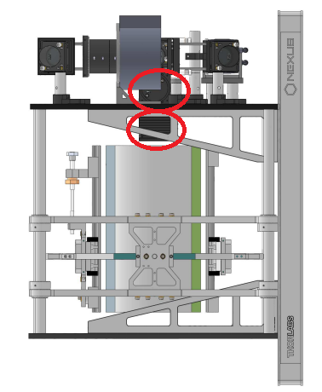
Proof of Concept Prototype
Wavelength Scan
Polarization State Scan
Inversion Models
Stokes Parameters (I,Q,U,V)
Telescope
Magnetic Field Estimate
Sensor (Cameras)

Slide 37
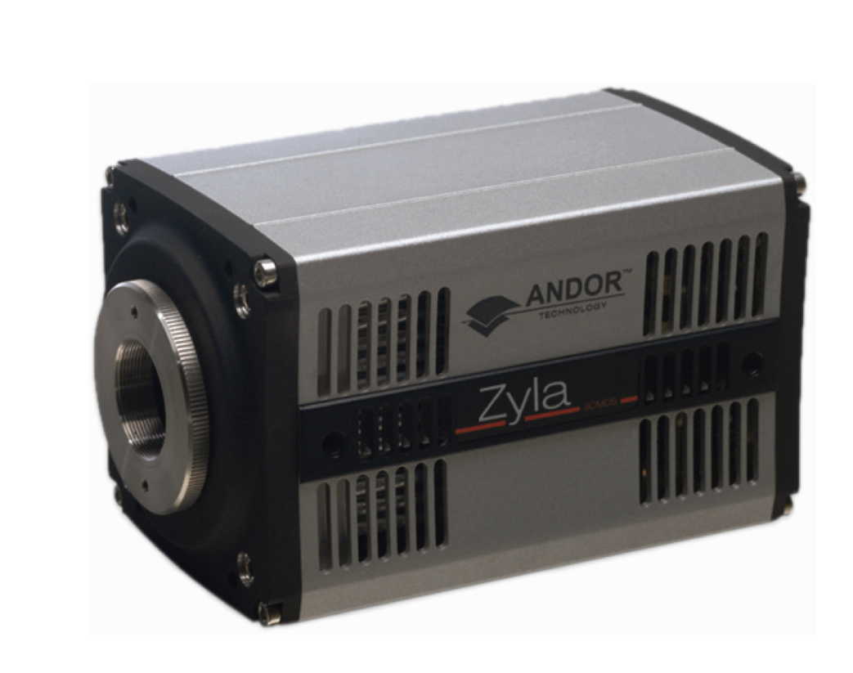
Proof of Concept Prototype: Camera
Model: Zyla 5.5
Detector: CMOS
Active pixels: 2560 x 2160 (5.5 Megapixel)
Sensor size: 16.6 x 14.0 mm 21.8 mm diagonal
Pixel size: 6.5 μm x 6,5 μm
Pixel readout rate (fast mode): 560MHz
Quantum efficiency: 60%
Water cooled (-10°C)
Linearity: Better than 99%
Frame rate: 50 frames per second in the 2048 x 2048 resolution
High rate of acquisition of sCMOS (frame rate) and the high size of the images (due to high resolution).
Notes:
Modelo: Zyla 5.5
Detector: CMOS
Resolução: 2560 x 2160 (5.5 Megapixel)
Tamanho do detector: 16.6 x 14.0 mm 21.8 mm diagonal
Tamanho do pixel: 6.5 μm
Taxa de leitura: até 560MHz
Eficiência Quântica: 60%
Refrigerado à água (-10°C)
Quantização radiométrica: 12 ou 16 bits

Slide 38
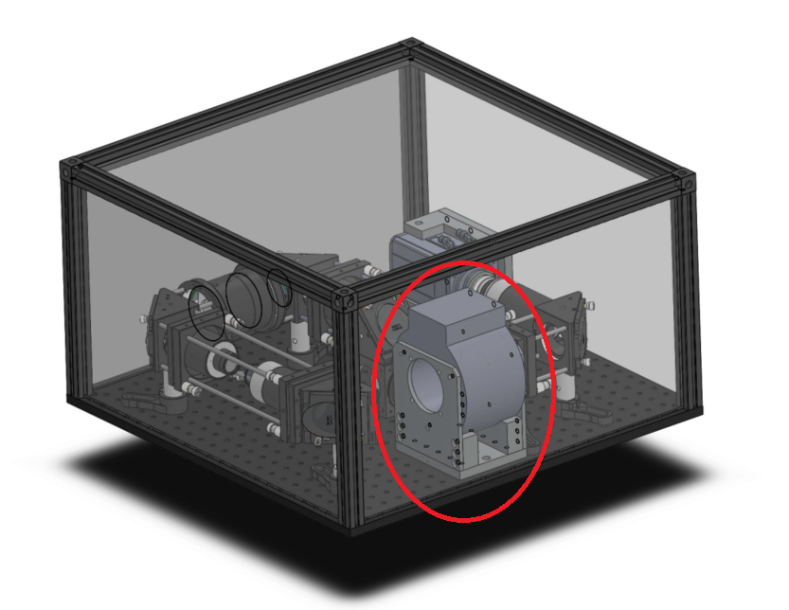
Fabry-Perot Interferometer (Etalon)
The wavelength range of interest: | 6301.5 and 6302.5 Angstroms
Required finesse: | 50
Reflectivity: | 95%
Thickness: | TBD
Free Spectral Range (FSR) : | 2.5 Angstroms
The number of etalons you will require for your project: | 1
Required working aperture: | 70 mm
Temperature range: | 15-35 C
Physical diameter: | 74 mm
Notes:
Modelo: Zyla 5.5
Detector: CMOS
Resolução: 2560 x 2160 (5.5 Megapixel)
Tamanho do detector: 16.6 x 14.0 mm 21.8 mm diagonal
Tamanho do pixel: 6.5 μm
Taxa de leitura: até 560MHz
Eficiência Quântica: 60%
Refrigerado à água (-10°C)
Quantização radiométrica: 12 ou 16 bits

Slide 39
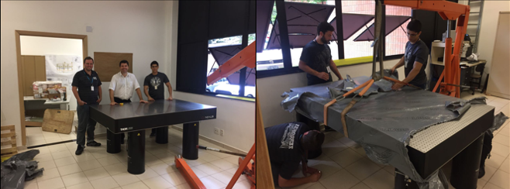
System Integration and alignment
Notes:
Modelo: Zyla 5.5
Detector: CMOS
Resolução: 2560 x 2160 (5.5 Megapixel)
Tamanho do detector: 16.6 x 14.0 mm 21.8 mm diagonal
Tamanho do pixel: 6.5 μm
Taxa de leitura: até 560MHz
Eficiência Quântica: 60%
Refrigerado à água (-10°C)
Quantização radiométrica: 12 ou 16 bits

Slide 40
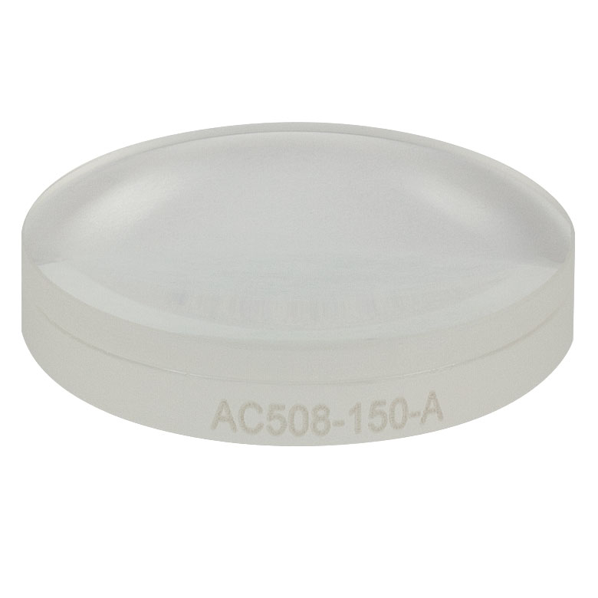
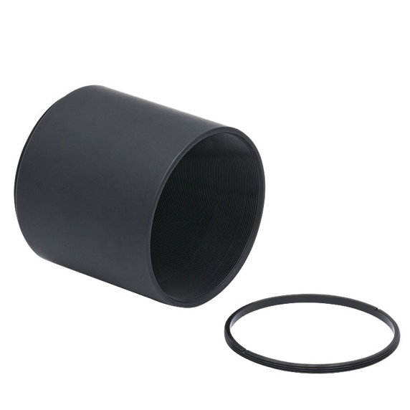
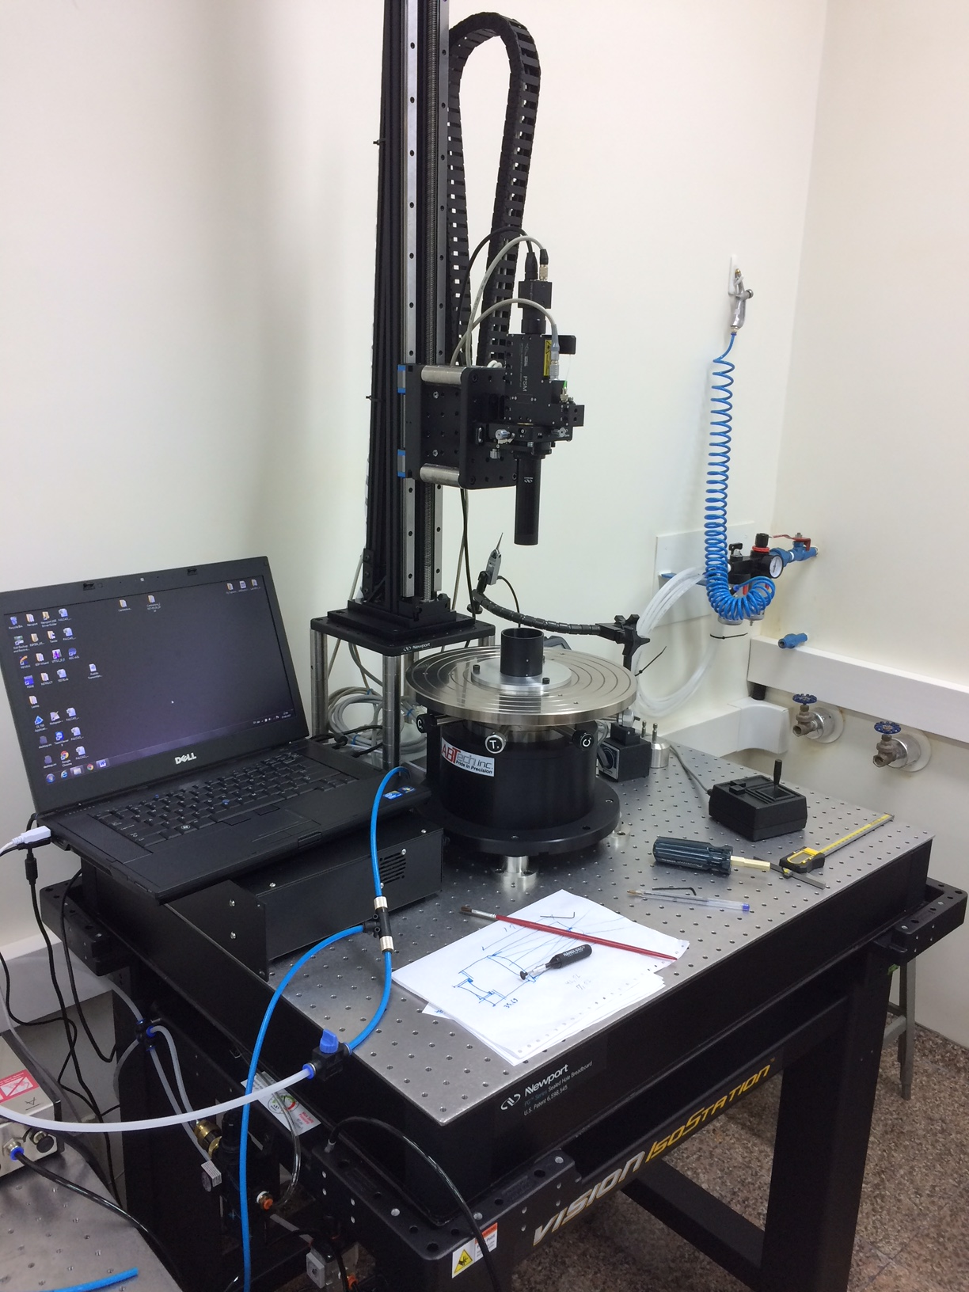
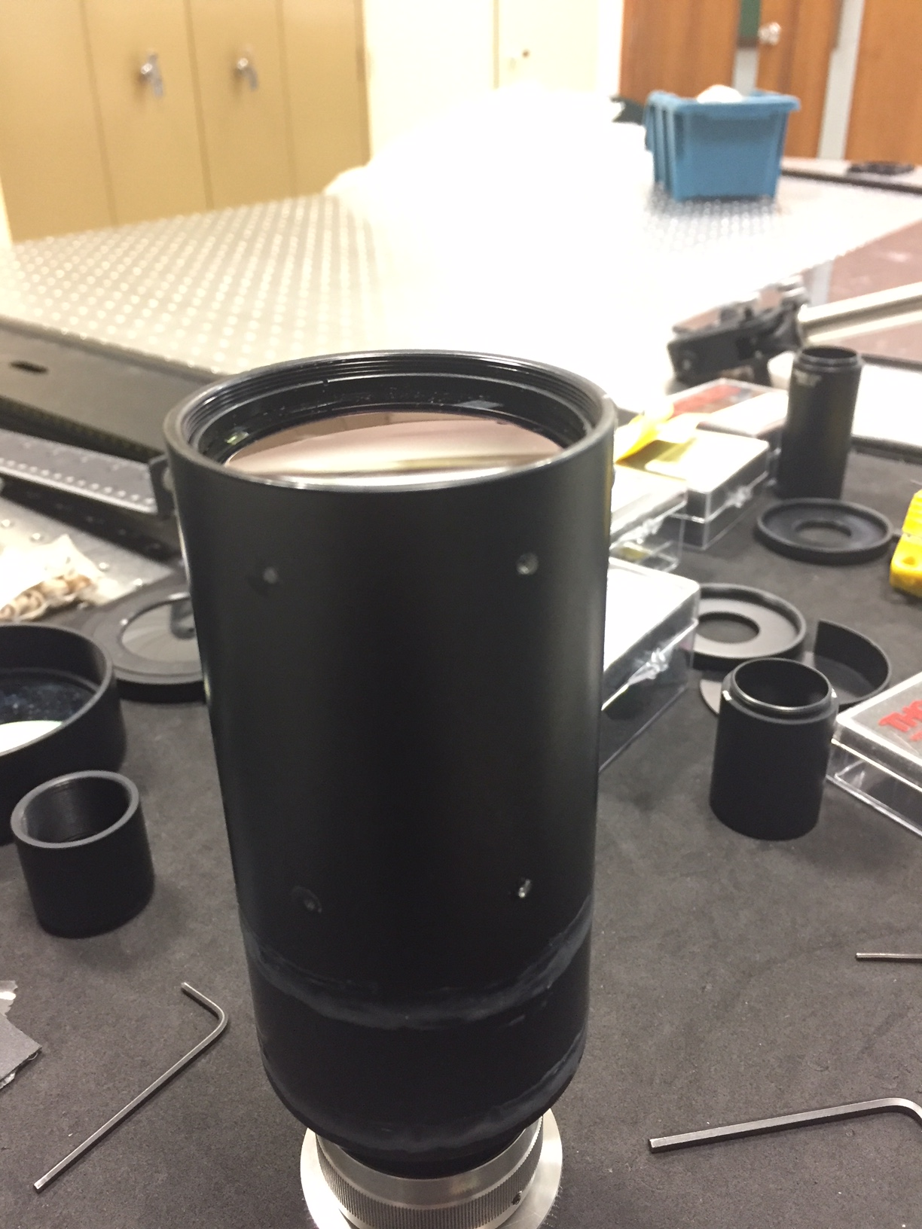
System Integration and alignment
IO Implementation
Notes:
Modelo: Zyla 5.5
Detector: CMOS
Resolução: 2560 x 2160 (5.5 Megapixel)
Tamanho do detector: 16.6 x 14.0 mm 21.8 mm diagonal
Tamanho do pixel: 6.5 μm
Taxa de leitura: até 560MHz
Eficiência Quântica: 60%
Refrigerado à água (-10°C)
Quantização radiométrica: 12 ou 16 bits

Slide 41
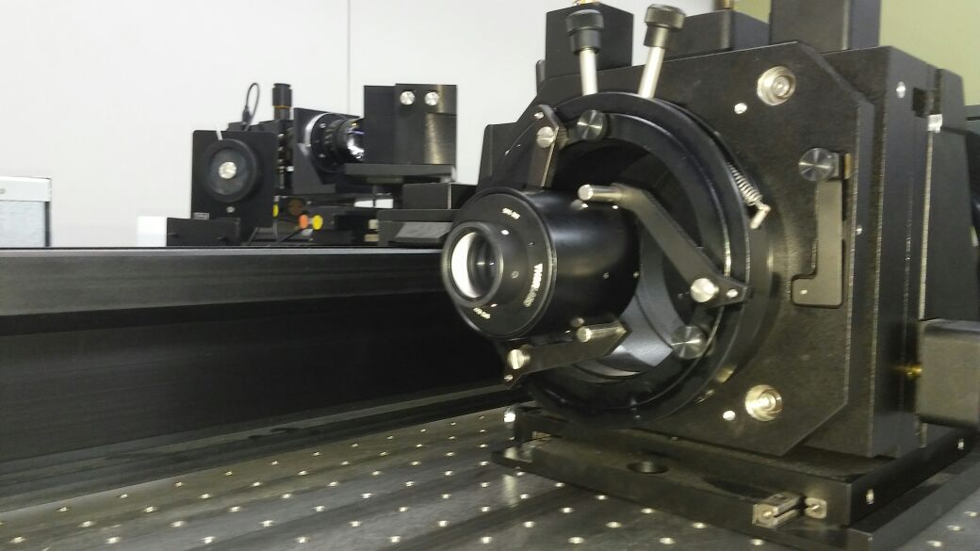
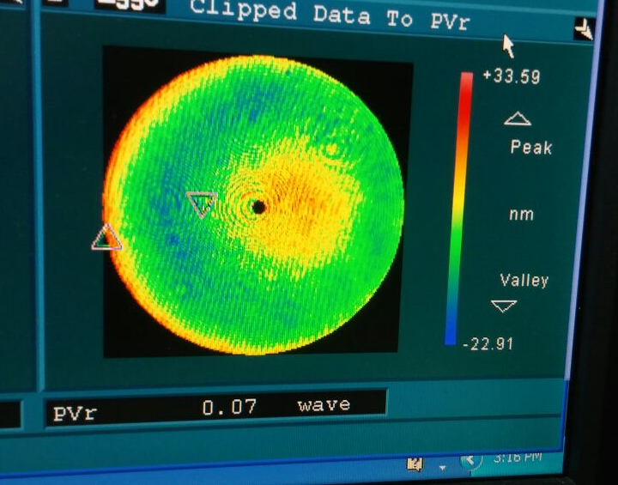
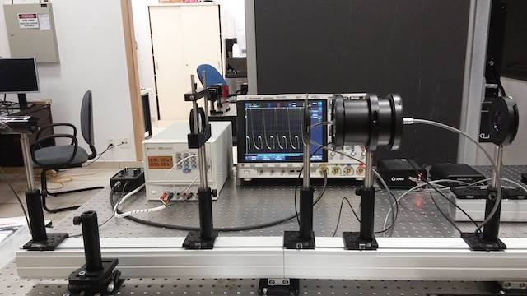

System Integration and alignment
Parts validation
Notes:
Modelo: Zyla 5.5
Detector: CMOS
Resolução: 2560 x 2160 (5.5 Megapixel)
Tamanho do detector: 16.6 x 14.0 mm 21.8 mm diagonal
Tamanho do pixel: 6.5 μm
Taxa de leitura: até 560MHz
Eficiência Quântica: 60%
Refrigerado à água (-10°C)
Quantização radiométrica: 12 ou 16 bits

Slide 42

System Integration and alignment
Notes:
Modelo: Zyla 5.5
Detector: CMOS
Resolução: 2560 x 2160 (5.5 Megapixel)
Tamanho do detector: 16.6 x 14.0 mm 21.8 mm diagonal
Tamanho do pixel: 6.5 μm
Taxa de leitura: até 560MHz
Eficiência Quântica: 60%
Refrigerado à água (-10°C)
Quantização radiométrica: 12 ou 16 bits

Slide 43

System Integration and alignment
Notes:
Modelo: Zyla 5.5
Detector: CMOS
Resolução: 2560 x 2160 (5.5 Megapixel)
Tamanho do detector: 16.6 x 14.0 mm 21.8 mm diagonal
Tamanho do pixel: 6.5 μm
Taxa de leitura: até 560MHz
Eficiência Quântica: 60%
Refrigerado à água (-10°C)
Quantização radiométrica: 12 ou 16 bits

Slide 44

System Integration and alignment
Notes:
Modelo: Zyla 5.5
Detector: CMOS
Resolução: 2560 x 2160 (5.5 Megapixel)
Tamanho do detector: 16.6 x 14.0 mm 21.8 mm diagonal
Tamanho do pixel: 6.5 μm
Taxa de leitura: até 560MHz
Eficiência Quântica: 60%
Refrigerado à água (-10°C)
Quantização radiométrica: 12 ou 16 bits

Slide 45

Fabry-Perot Interferometer (Etalon)
Example of a solar disk image acquired employing the proof of concept version of the spectropolarimeter
The concentric rings indicate regions were the interference is positive for the same wavelength in the region of interest. The two Fe I lines that will be employed to estimate the magnetic field are indicated in the figure.
Notes:
Modelo: Zyla 5.5
Detector: CMOS
Resolução: 2560 x 2160 (5.5 Megapixel)
Tamanho do detector: 16.6 x 14.0 mm 21.8 mm diagonal
Tamanho do pixel: 6.5 μm
Taxa de leitura: até 560MHz
Eficiência Quântica: 60%
Refrigerado à água (-10°C)
Quantização radiométrica: 12 ou 16 bits

Slide 46

Fabry-Perot Interferometer (Etalon)
Example of a solar disk image acquired employing the proof of concept version of the spectropolarimeter
Notes:
Modelo: Zyla 5.5
Detector: CMOS
Resolução: 2560 x 2160 (5.5 Megapixel)
Tamanho do detector: 16.6 x 14.0 mm 21.8 mm diagonal
Tamanho do pixel: 6.5 μm
Taxa de leitura: até 560MHz
Eficiência Quântica: 60%
Refrigerado à água (-10°C)
Quantização radiométrica: 12 ou 16 bits

Slide 47


Fabry-Perot Interferometer (Etalon)
First reconstruction of the stokes V parameter obtained employing the proof of concept prototype (left)
SDO/NASA
Notes:
Modelo: Zyla 5.5
Detector: CMOS
Resolução: 2560 x 2160 (5.5 Megapixel)
Tamanho do detector: 16.6 x 14.0 mm 21.8 mm diagonal
Tamanho do pixel: 6.5 μm
Taxa de leitura: até 560MHz
Eficiência Quântica: 60%
Refrigerado à água (-10°C)
Quantização radiométrica: 12 ou 16 bits

Slide 48

Fabry-Perot Interferometer (Etalon)
First reconstruction of the stokes V parameter obtained employing the proof of concept prototype (left)
SDO/NASA
Notes:
Modelo: Zyla 5.5
Detector: CMOS
Resolução: 2560 x 2160 (5.5 Megapixel)
Tamanho do detector: 16.6 x 14.0 mm 21.8 mm diagonal
Tamanho do pixel: 6.5 μm
Taxa de leitura: até 560MHz
Eficiência Quântica: 60%
Refrigerado à água (-10°C)
Quantização radiométrica: 12 ou 16 bits

Slide 49
Project Planning
2014
2015
2016
2017
2018
2019
2020
2021
2023
2022
Development of the Proof of Concept
Magnetograph
Ground Based Solar Telescope
Galileo Solar Space Telescope
Out-of-the-ecliptic Solar Observatory
Understanding the Origin of Solar Activity and its Impact on Geospace.
Out-of-the-Ecliptic Observations of the Solar Atmosphere, Magnetic Field and Irradiance

Slide 50


Optical Telescope
Model: | Ritchey-Chrétien
Aperture: | 500 mm
Focal Length: | 4000 mm
Focal Ratio: | F8
Back Focus: | 365 mm
Field of View: | 69 arc minutes
Coating: | Coating with 99% Reflection
Surface quality: | Wave front higher than 95 Strehl
Material for the primary and secondary mirrors: | A lithium aluminosilicate glass-ceramic material with thermal expansion coefficient lower than 0.05x10⁻⁶ /K between 20ºC and 300ºC
Notes:
The rationale behind this choice was better optical performance over Schimidt-Cassegrain and Gregorian designs and compact size compared to an achromatic lens. The aperture size of 500 mm was chosen for considerations for the SNR and cadence requirements. The focal length of 4000 m gives a f/8 system. The design was done using Zemax software and was optimized for the wavelength of 630 nm.

Slide 51
Intermediate Prototype
Model: | Ritchey-Chrétien
Aperture: | 500 mm
Focal Length: | 4000 mm
Focal Ratio: | F8
Back Focus: | 365 mm
Field of View: | 69 arc minutes
Coating: | Coating with 99% Reflection
Surface quality: | Wave front higher than 95 Strehl
Material for the primary and secondary mirrors: | A lithium aluminosilicate glass-ceramic material with thermal expansion coefficient lower than 0.05x10⁻⁶ /K between 20ºC and 300ºC
Notes:
Modelo: Zyla 5.5
Detector: CMOS
Resolução: 2560 x 2160 (5.5 Megapixel)
Tamanho do detector: 16.6 x 14.0 mm 21.8 mm diagonal
Tamanho do pixel: 6.5 μm
Taxa de leitura: até 560MHz
Eficiência Quântica: 60%
Refrigerado à água (-10°C)
Quantização radiométrica: 12 ou 16 bits

Slide 52



Intermediate Prototype
Notes:
Modelo: Zyla 5.5
Detector: CMOS
Resolução: 2560 x 2160 (5.5 Megapixel)
Tamanho do detector: 16.6 x 14.0 mm 21.8 mm diagonal
Tamanho do pixel: 6.5 μm
Taxa de leitura: até 560MHz
Eficiência Quântica: 60%
Refrigerado à água (-10°C)
Quantização radiométrica: 12 ou 16 bits

Slide 53



Observatory
Later it will be installed in the Observatório do Pico dos Dia in partnership with the LNA

Slide 54







Sensor Elements
Broadband Radiometer
.
Observation of the variability of the total solar irradiance
Instrument: Absolute Radiometer
Approach: Electrical Substitution Radiometer
Leading Development Team: CTE/INPE and DIDGE/INPE
High absorption coating
Proof of Concept Model
Baffles
Shutter
High absorption cavity
Sensor Elements
Precision Aperture
Notes:
Modelo: Zyla 5.5
Detector: CMOS
Resolução: 2560 x 2160 (5.5 Megapixel)
Tamanho do detector: 16.6 x 14.0 mm 21.8 mm diagonal
Tamanho do pixel: 6.5 μm
Taxa de leitura: até 560MHz
Eficiência Quântica: 60%
Refrigerado à água (-10°C)
Quantização radiométrica: 12 ou 16 bits

Slide 55


Broadband Radiometer
High absorption coating
Notes:
Modelo: Zyla 5.5
Detector: CMOS
Resolução: 2560 x 2160 (5.5 Megapixel)
Tamanho do detector: 16.6 x 14.0 mm 21.8 mm diagonal
Tamanho do pixel: 6.5 μm
Taxa de leitura: até 560MHz
Eficiência Quântica: 60%
Refrigerado à água (-10°C)
Quantização radiométrica: 12 ou 16 bits

Slide 56

Zeeman Effect Experiment
Notes:
Modelo: Zyla 5.5
Detector: CMOS
Resolução: 2560 x 2160 (5.5 Megapixel)
Tamanho do detector: 16.6 x 14.0 mm 21.8 mm diagonal
Tamanho do pixel: 6.5 μm
Taxa de leitura: até 560MHz
Eficiência Quântica: 60%
Refrigerado à água (-10°C)
Quantização radiométrica: 12 ou 16 bits

Slide 57
Galileo Solar Space Telescope | GSST
Development of Instrumentation for Solar Observations at the Brazilian National Institute for Space Research (INPE)
Understanding the Origin of Solar Activity and its Impact on Geospace.
Observations of the Solar Atmosphere, Magnetic Field and Irradiance
Notes:
Incluir o Símbolo da AEB.

